Slide 1
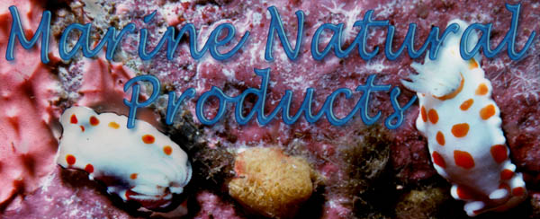

Welcome to Bio2990
DUC Research Methodology
Marine Natural Products - Chemistry
Dr. Tyler Johnson
Matthew Nickel
Natalie Oyler
Department of Natural Sciences
Notes:
1

Slide 2
Outline
Orientation: (15 min) CONSULTANTS
  Syllabus
  Assignments
Introduction to Marine Natural Products Chemistry
& Chemical Biology
Turbo extraction of your sponge
Short course in:
  A) Organic Chemistry, B) Polar vs Non polar Chemistry
  B) Drawing BioOrganic & Medicinal Chemistry - Molecular structures
Mini power point tutorial
Adjourn

Slide 3
Outline
Orientation: (15 min) CONSULTANTS
  Syllabus
  Assignments
Introduction to Marine Natural Products Chemistry
& Chemical Biology
Turbo extraction of your sponge
Short course in:
  A) Organic Chemistry, B) Polar vs Non polar Chemistry
  B) Drawing BioOrganic & Medicinal Chemistry - Molecular structures
Mini power point tutorial
Adjourn

Slide 4
1st Assignment – Icebreaker (2 min. ea)
Introduce ourselves:
Name
Major – Chemistry / Biochemistry preferred ☺
What you want to be when grow up?
(Vocational goals?
4) Fun or interesting fact about you?
5) Introduce your neighbor’s (1-4)

Slide 5
Sponge Extraction Video - SOP

Slide 6
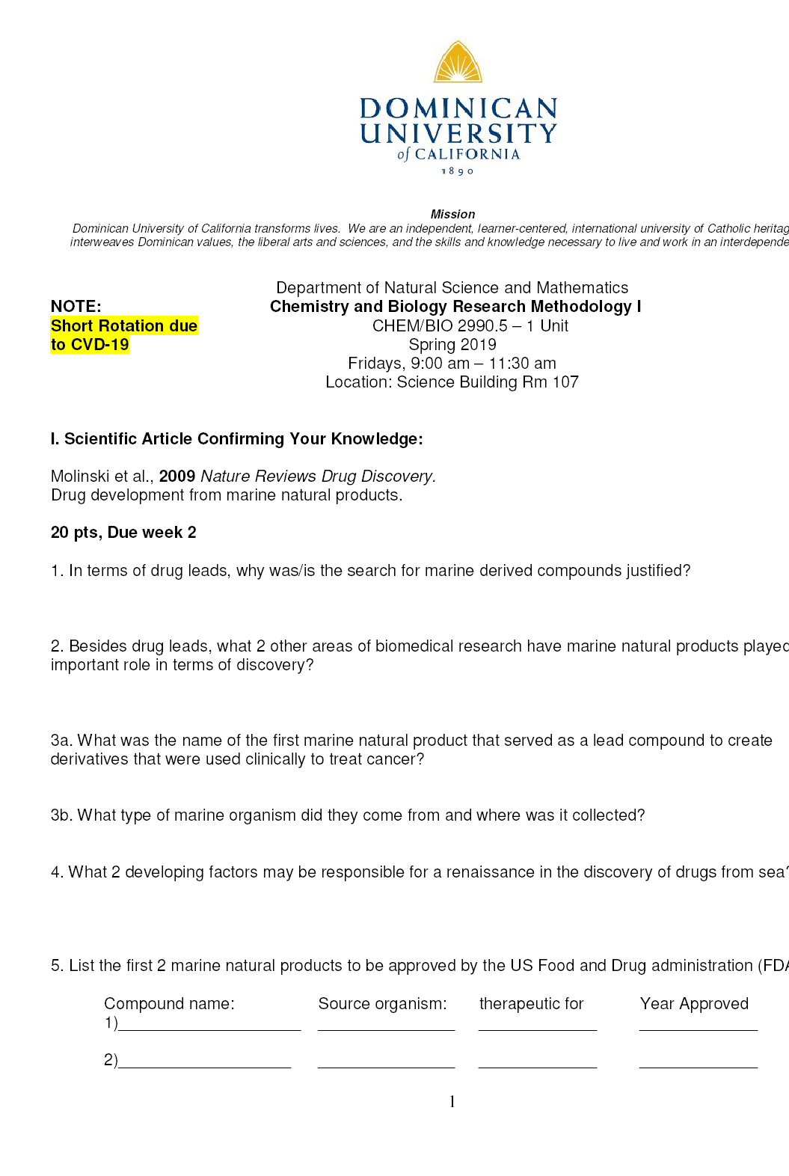
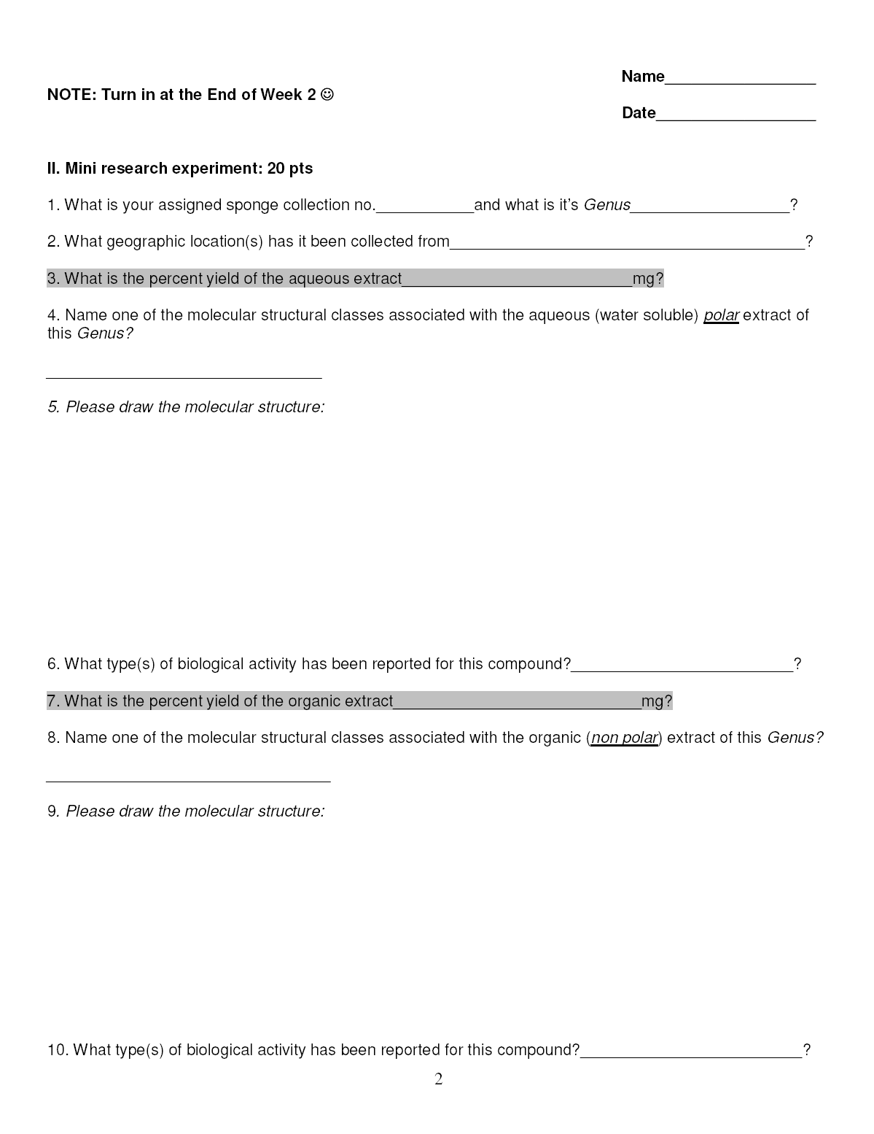
Bio 2999 - Worksheet

Slide 7
Outline
Orientation: (15 min) CONSULTANTS
  Syllabus
  Assignments
Introduction to Marine Natural Products Chemistry
& Chemical Biology
Turbo extraction of your sponge
Short course in:
  A) Organic Chemistry, B) Polar vs Non polar Chemistry
  B) Drawing BioOrganic & Medicinal Chemistry - Molecular structures
Mini power point tutorial
Adjourn

Slide 8
