Slide 1
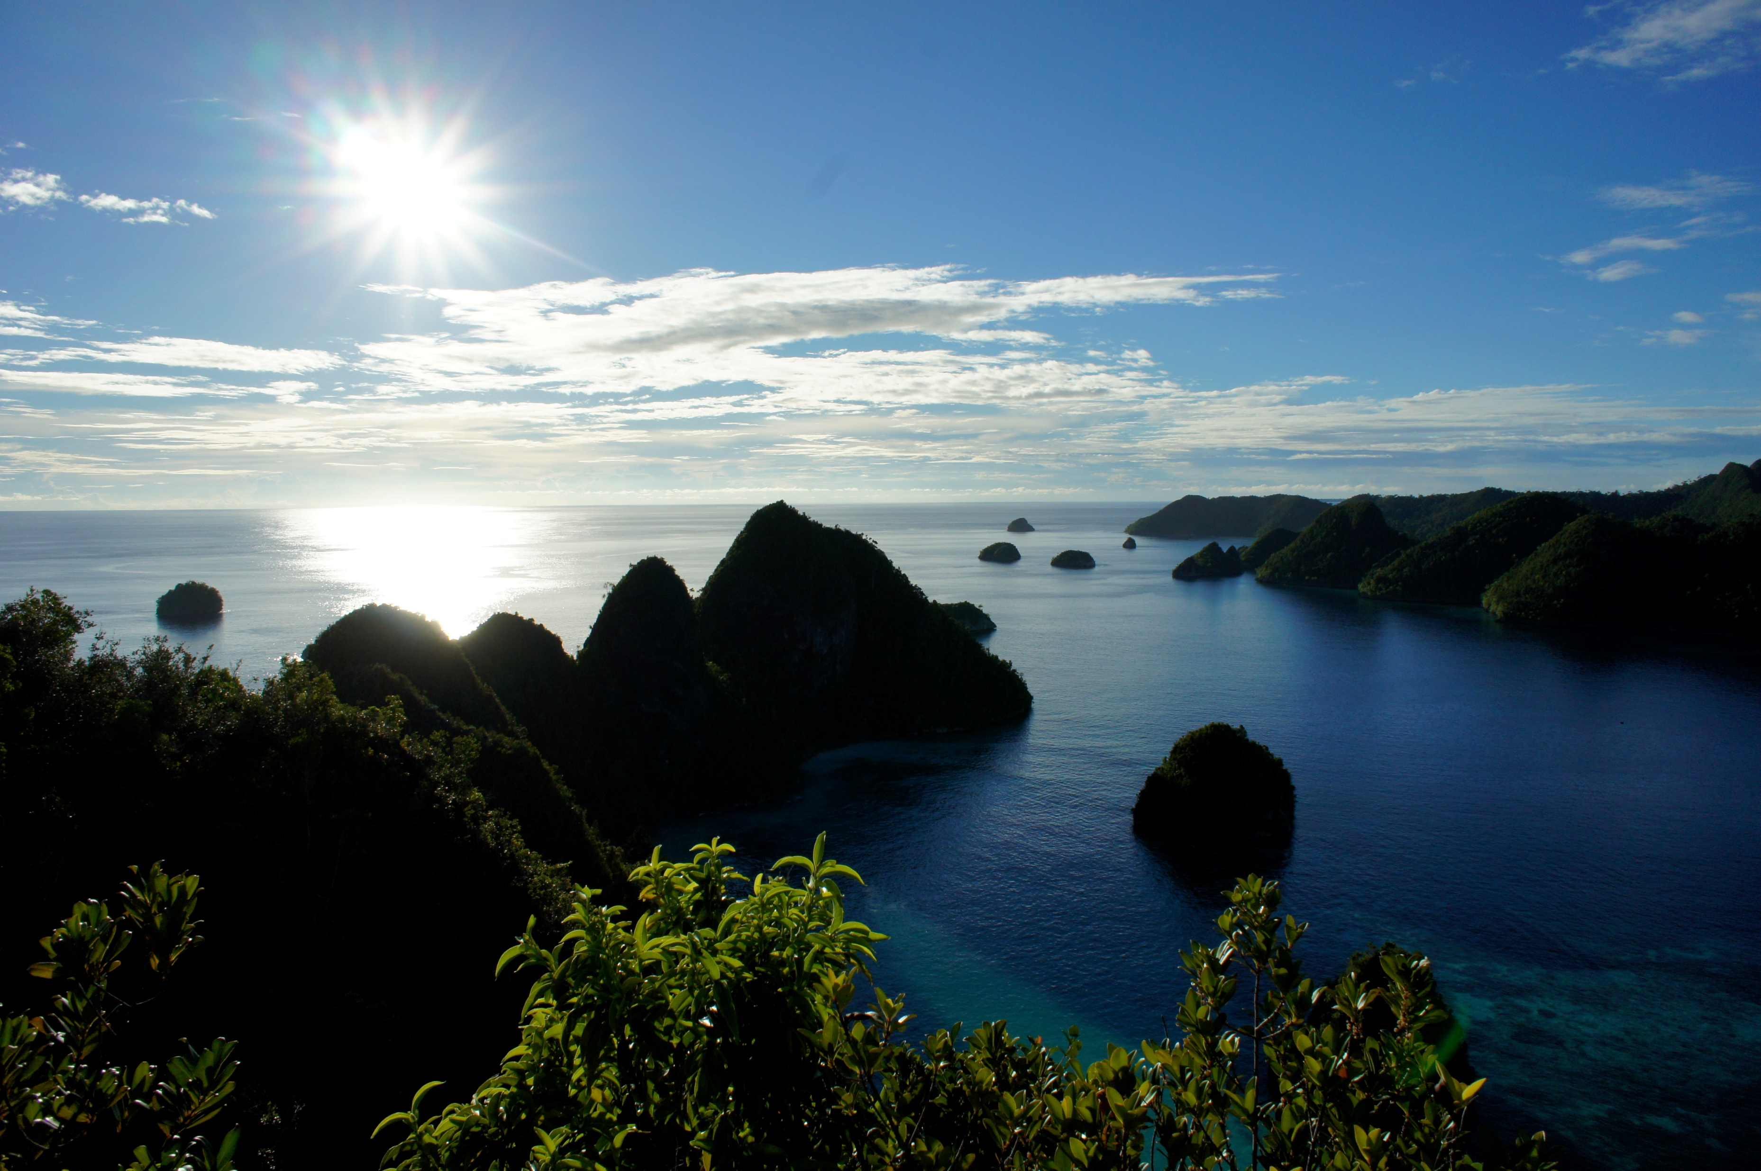
From Sea to Pharmacy
& Chemical Biology
Matt Nickel, Natalie Oyler, Tyler Johnson
Department of Natural Sciences & Mathematics
Dominican University of California

Slide 2
Outline
Chemical Biology
What are Natural Products?
Why study Marine Natural Products (MNP)?
Selected examples of MNPs in Chemical Biology
Conclusions
Acknowledgements

Slide 3
Outline
Chemical Biology
What are Natural Products?
Why study Marine Natural Products (MNP)?
Selected examples of MNPs in Chemical Biology
Conclusions
Acknowledgements

Slide 4
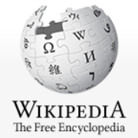
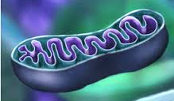
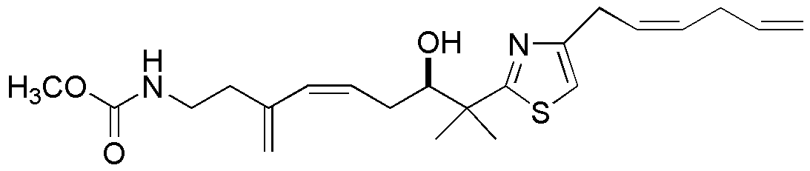
Chemical Biology
What is it?
A scientific discipline spanning the fields of chemistry, biology, and physics.
It involves the application of chemical techniques, tools, and analyses, using
compounds from synthetic and natural products chemistry, to the study and
manipulation of biological systems.
Chemical biologists attempt to use chemical principles (e.g. molecules as probes)
to alter systems to either investigate the underlying biology or create new function.
Research done by chemical biologists is often closely related to that of cell biology
vs biochemistry.
Biochemists study the chemistry of biomolecules and regulation of biochemical
pathways within cells and tissues, e.g. cAMP or cGMP….
Chemical biologists deal with novel or known chemical compounds (usually small)
with new applications to biology.

Slide 5
Outline
Chemical Biology
What are Natural Products?
Why study Marine Natural Products (MNP)?
Selected examples of MNPs in Chemical Biology
Conclusions
Acknowledgements

Slide 6
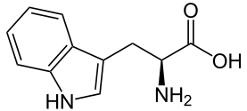
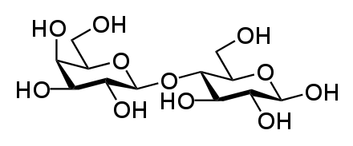
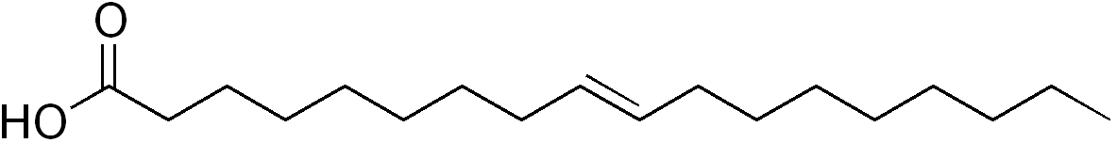
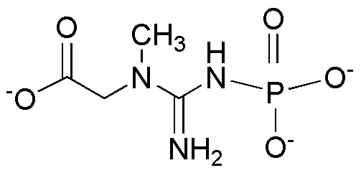
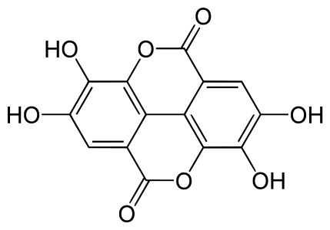
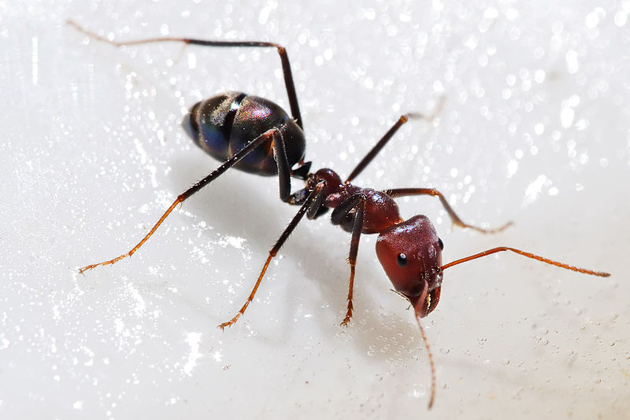
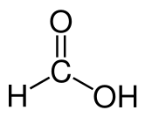
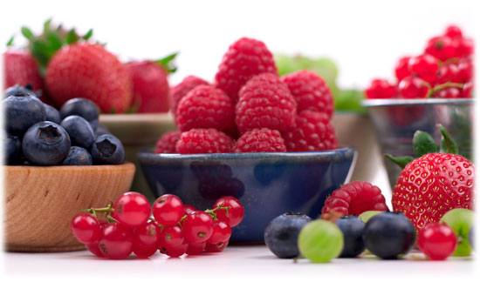

What are Natural Products?
  1. Primary metabolites = essential
      Fats (lipids)
      Amino acids (proteins)
      Carbohydrates (sugars)
2. Secondary metabolites = not essential
  confer selective evolutionary advantages to host organism as in:
creatine phosphate
formic acid
ellagic acid
polyphenol
Chemical defense
deter predation
        Signaling / Cellular Maintenance
        Signaling molecules in ripening
        Protection from UV radiation
        Antioxidant
        Metabolism
        Krebs Cycle intermediate
        Boosts aerobic performance

Slide 7
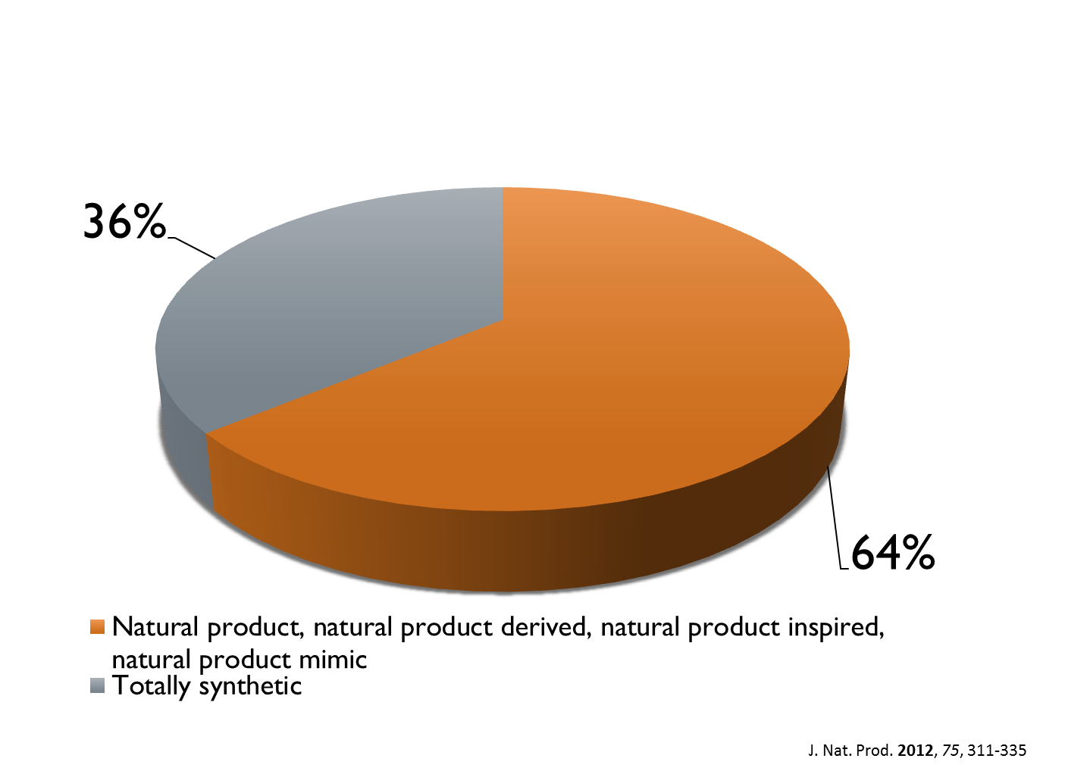
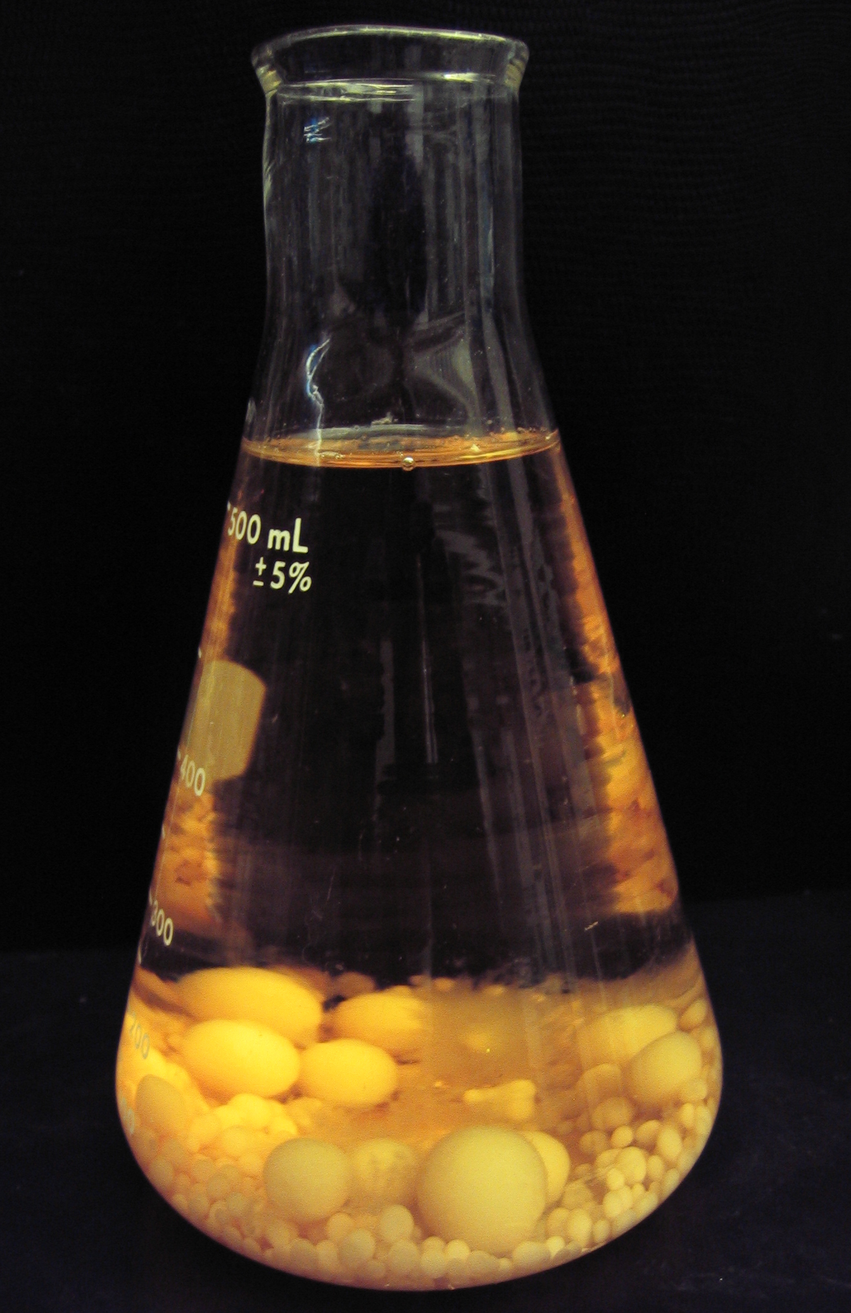
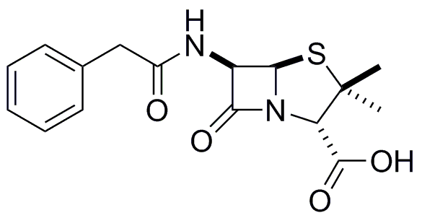
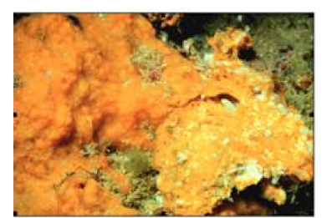
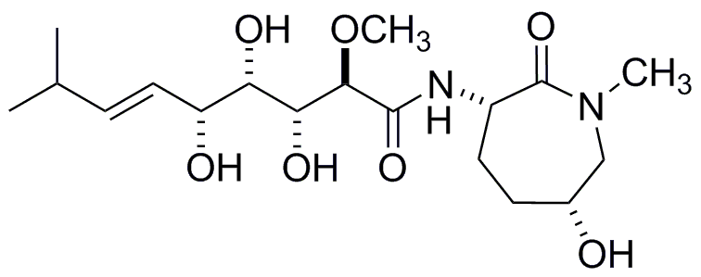
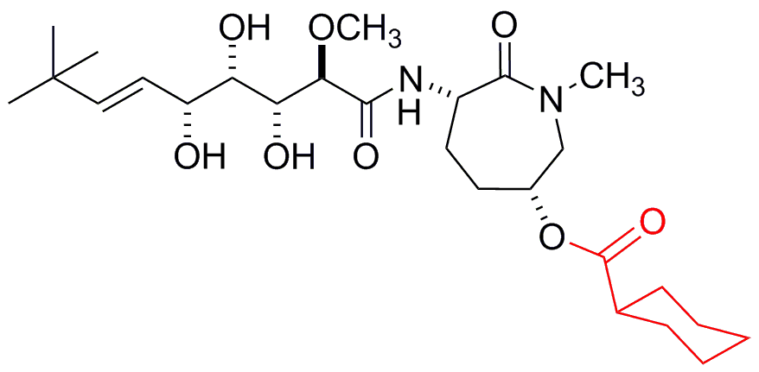
Why study Natural Products Chemistry?
Major Source - FDA approved Drugs & Lead Structures (1980-2010)
Drug
Synthetic
Natural Products
penicillin G
~ 1940s
1st anti-biotics
P. rubens
(fungus)
Therapeutic Lead Structure Drug
Semi-synthetic derivative
evaluated clinically for cancer
(Novartis - 2003)
MOA – MetAP
J. coriacea
(sponge)
bengamides
1986
LAF 389
Newman and Cragg, 2009, Chem. Rev. Newman and Cragg, 2012, J. Nat. Prod., Crews et al., 1986, J. Org. Chem.

Slide 8
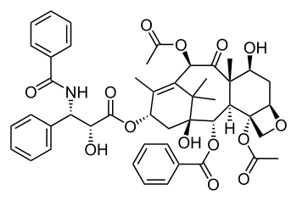
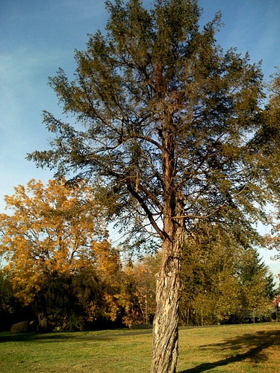
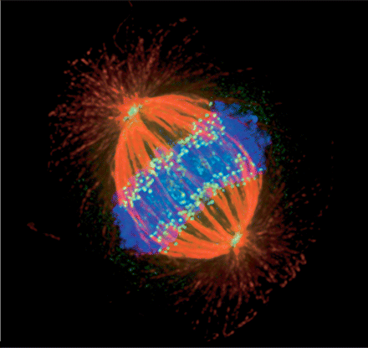
Taxol (Paclitaxel)
Greatest Selling Anti-Cancer Drug
A secondary metabolite first isolated from the bark of a US Pacific Yew tree in 1967
FDA approved 1989
Cancer
(breast, ovarian, lung)
Mechanism of Action (MOA) involves stabilizing microtubules, which interferes with mitosis
Cancer cells often have a high mitotic index and never stop propagating so this is an effective way to target them
Normal cell division

Slide 9
Outline
Chemical Biology
What are Natural Products?
Why study Marine Natural Products (MNP)?
Selected examples of MNPs in Chemical Biology
Conclusions
Acknowledgements

Slide 10
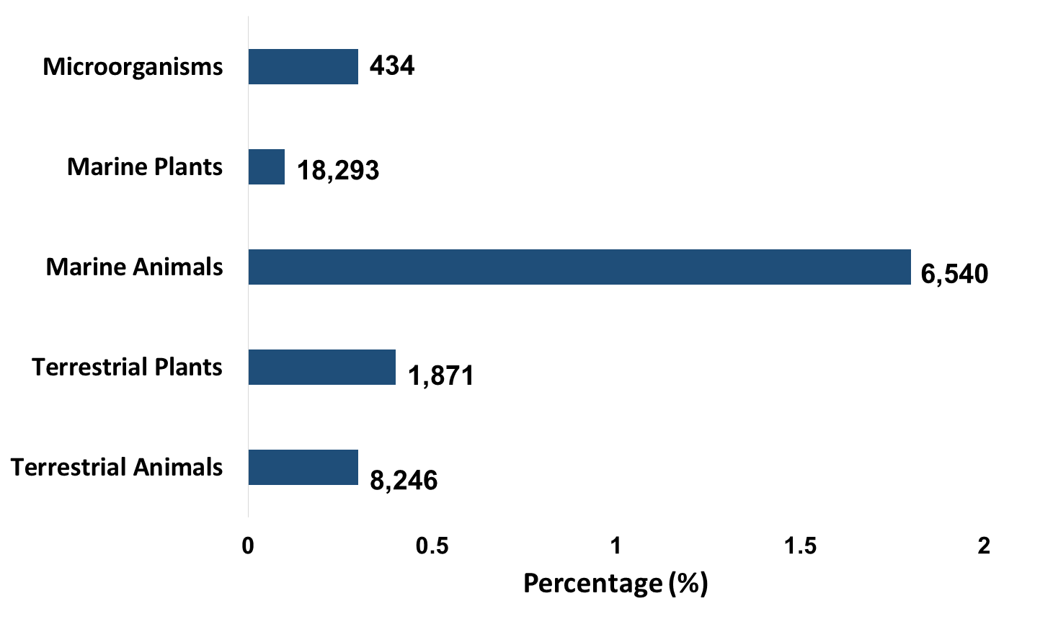
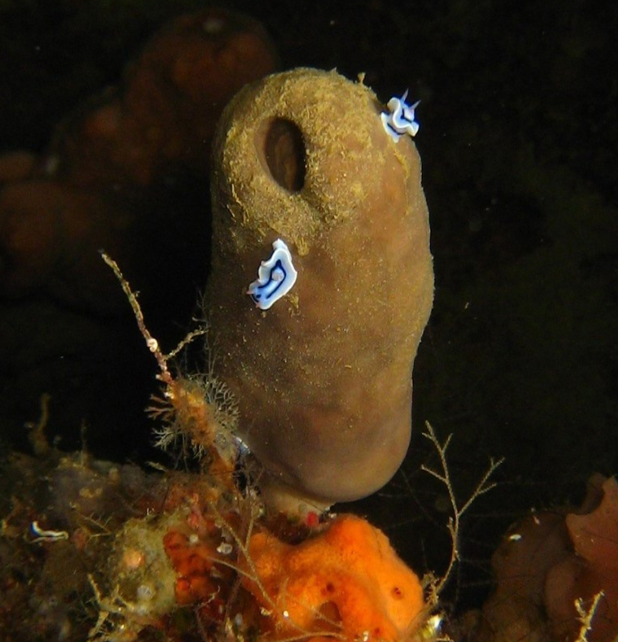
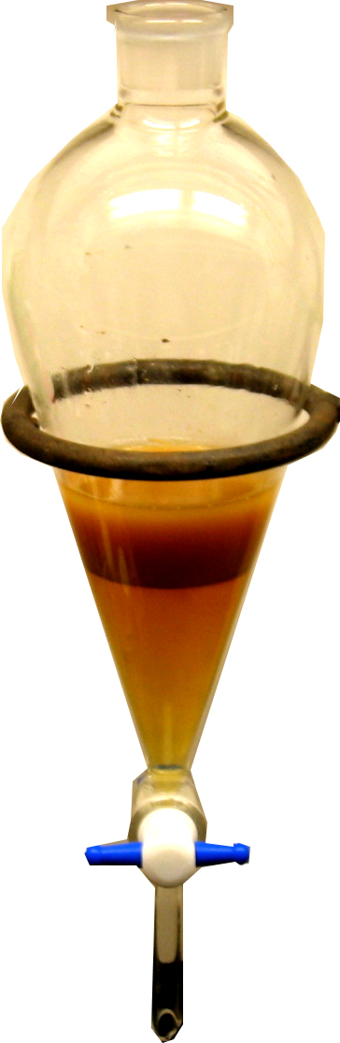
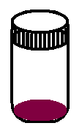
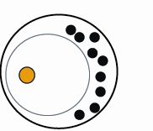
Why Study Marine Natural Products (MNP) ?
Cancer Leading Cause of Death in US
Extracts From Natural Product Sources (# in Bold)
8,246
1,872
extract?
(oil)
6,540
18,293
434
extracts of MNPs
4X Higher Bioactive
“Hit” rate in NCI
60 cell line
Bioactive Hit Rate
National Cancer Institutes (NCI)
Panel of 60 cancer cell lines
= extract
Recreated from Munro, M. H. G. et al., J. Biotechnol. 1999, 70, 15-25.
Notes:
Too congested synthetic (chemical diversity) Nat Prod more spread occupy greater space, more drug like properities,
Why Nat prod sign source of drug leads

Slide 11
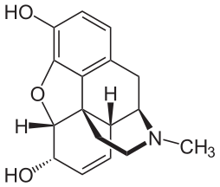
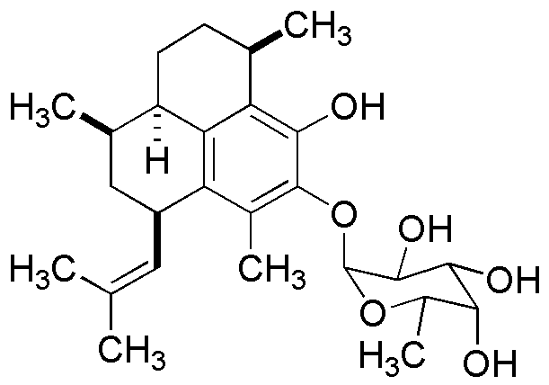
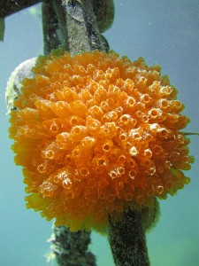
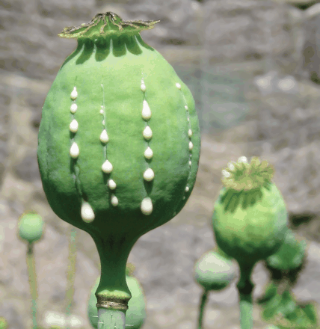
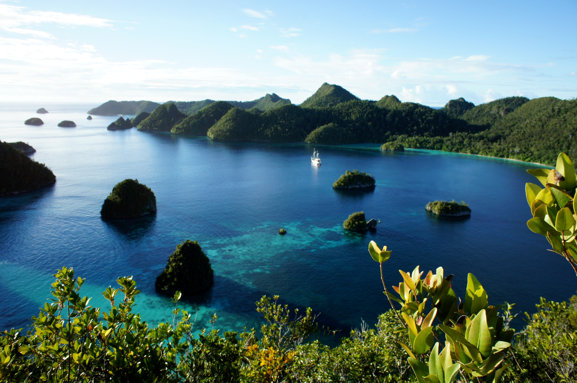
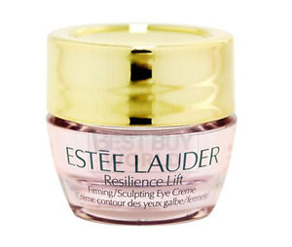
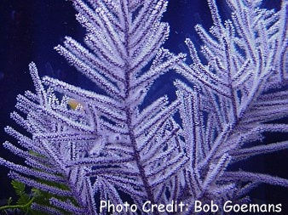
SOME HISTORY
The 1st Drug & Commercially available Marine Natural Product (MNP)
Morphine
Pseudoterosin A
171 years!!!
long time to wait
for medicines
from the sea….
1827 - 1st drug
(Pain)
1998 – 1st FDA approved MNP
(Anti-inflammatory - wrinkle cream)
Resilience®
Opium (poppy tears)
lachryma papaveris
(Asia)
Pseudopterogorgia elisabethae
(Caribbean)
Li and Vederas, 2009, Science, 325, 161.

Slide 12
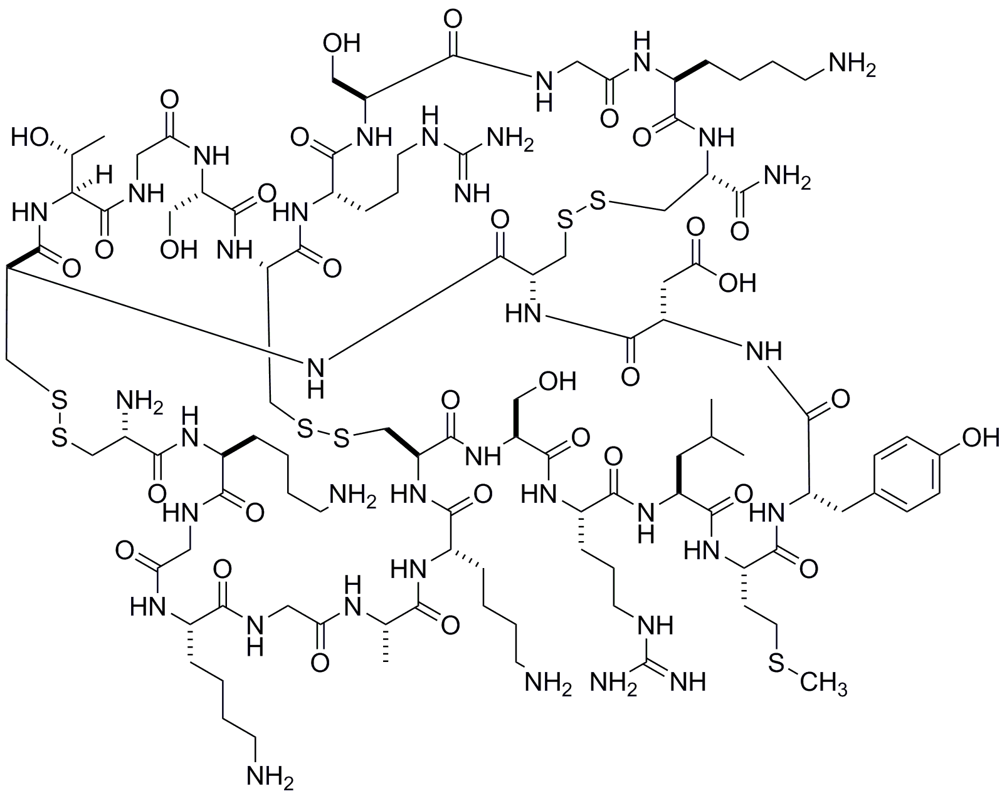
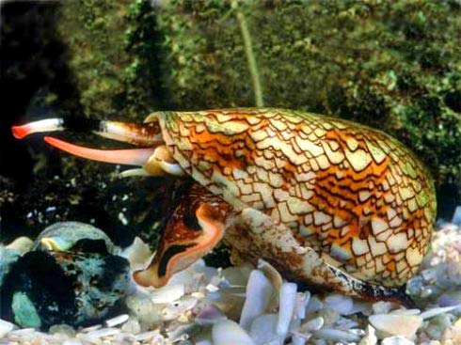

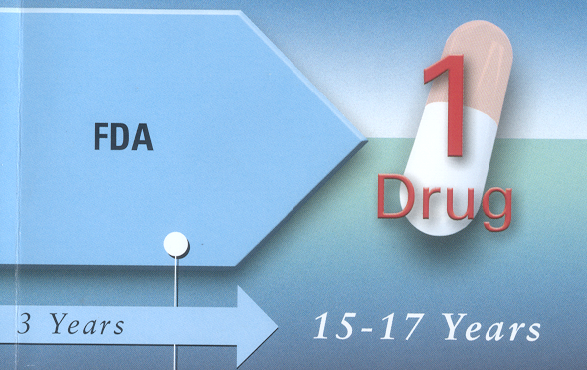
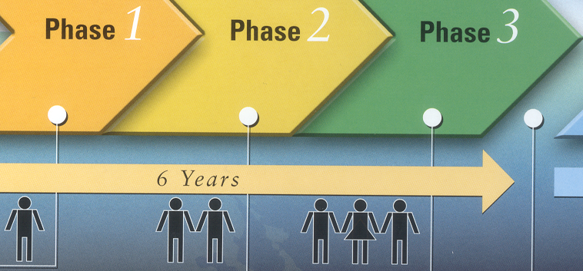
How do MNPs become Therapeutics?
Discovery & Development
In vitro studies: (3 years)
activity in cell lines
mechanism of action (MOA)
Conus geographus
II. In vivo evaluation (4 years)
Preclinical studies (pharmakokinetics etc.)
ziconotide (1982) → Prialt® (2004)
Time?
Cost?
$
III. Clinical evaluation (6 years)
1 in 5000 lead compounds
McIntosh, M.; Cruz L.J.; Hunkapiller, M.W.; Gray, W.R.; Olivera, B.M. 1982, Arch. Biochem. Biophys. 218, 329.
Notes:
Ziconotide acts as a selective N-type voltage-gated calcium channel blocker. Michael McIntosh (barely out of high school when published this w/ PI Baldomero Olivero

Slide 13
Outline
Chemical Biology
What are Natural Products?
Why study Marine Natural Products (MNP)?
Selected examples of MNPs in Chemical Biology
Conclusions
Acknowledgements

Slide 14
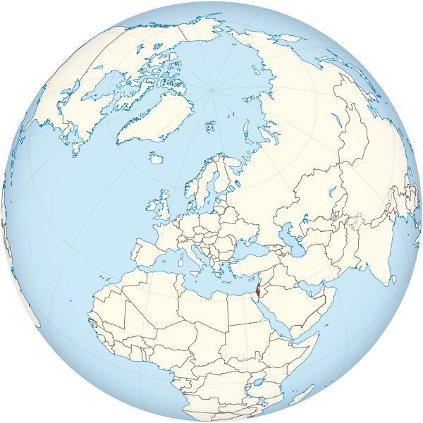
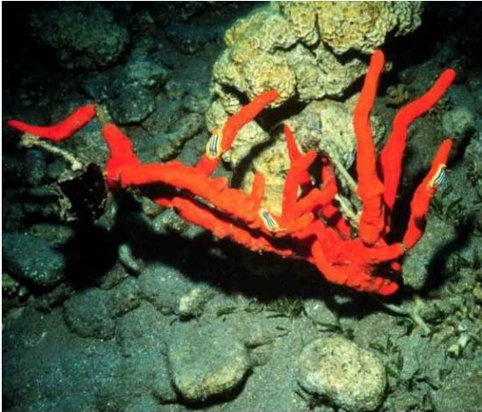
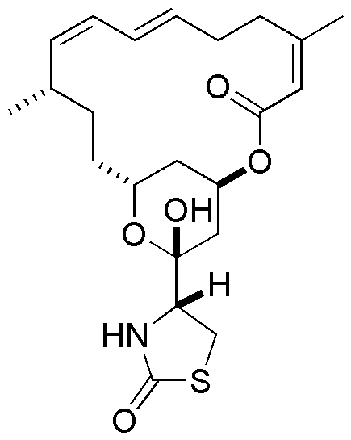
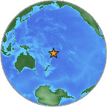
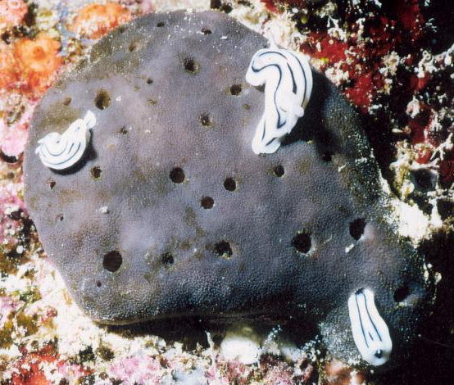
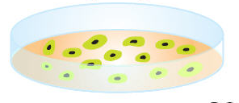
Not all MNP therapeutic leads that fail to get to the clinic are destined to Sit On the Shelf (SOS compounds).
Lat - A – selected example - Potent Molecular Probe
N. magnifica
Israel - 1980
Latrunculin A
C. mycofijiensis
Fiji - 1987
Selective cytotoxicity to cancer cell lines in vitro
failed to reach clinical trials - toxicity – in vivo studies
Mechanism of action (MOA) - Potent inhibitor of actin cytoskeletal assembly
(IC₅₀ ~35 nM)
Kashman et al., 1983,Science, 219, 493.
Crews et al., 1987, J. Nat. Prod. 50, 92.

Slide 15
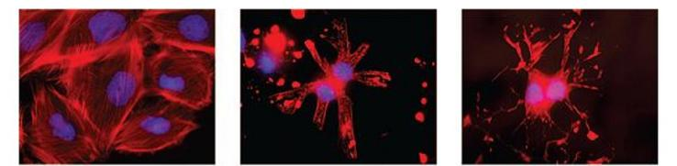
Not all MNPs that fail as possible drugs = dropped
Some become Important Molecular Probes in Chemical Biology
rat aerotic cells
rat aerotic cells
actin microfilaments
untreated control
actin - microfilaments
disrupted by latrunculin A
latrunculin A
RECALL: Chemical Biology is…
The application of chemical techniques and or molecular as probes to the study
and manipulation of biological systems
What do we mean by a molecular probe?
A compound that selectively binds to or alters a molecular or protein complex
and can be used as a tool to further study the role of that complex in detail
Amagata, T; Johnson, T.A.; Cichewicz, R. H.; Tenney, K.; Mooberry, S. L.; Valeriote, F. A.; Crews, P.
J. Med. Chem., 2008, 51, 7234-7242.
Marine Natural Products as Molecular Probes (actin inhibition)

Slide 16
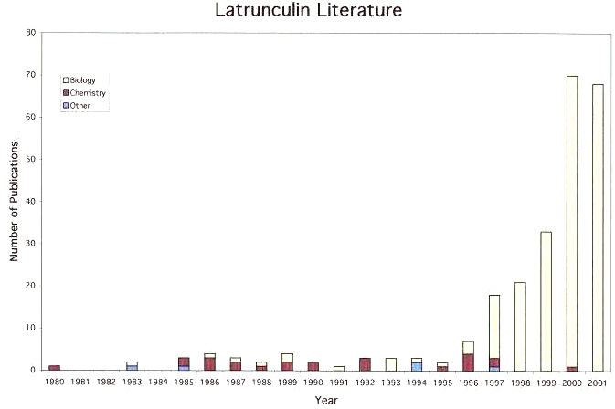
Marine Natural Products as Molecular Probes (actin inhibition)
1st generation - Powerful Molecular Probe ~ Chemical Biology
Scientific Literature
Biology
Chemistry
Other
Lat A
IC₅₀ 35 nM
G-Actin
*Ayscough, K.R.; Stryker, J.; Sanders, M.; Crews, P.; Drubin, D. G.
J. Cell Biology 1997, 137 (2): 399-416
Lat A → which proteins involved in assembling actin in the cell
Major surge of publications - Chemical Biology Study with Lat A
Most widely cited paper involving Lat A (528 citations)
Latrunculins most widely used molecular probes - G-actin study
*
Notes:
Not all bioactive Nat Prod have resulted in Therp Leads . . .some Molec Probes to interogate biological systems. .
Will come back to this when talk about bioactivty. .will show data in few slides
Important Researhers studying cell cycles alt. Therapeutic devlop.

Slide 17
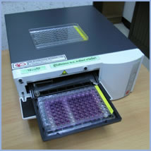

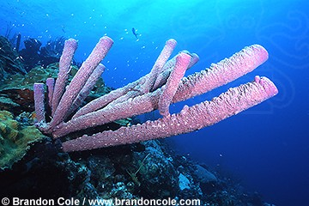
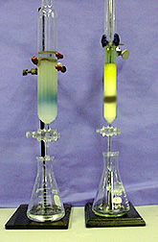

Open Repository of
100K Natural Product Extracts
Developmental
Therapeutics
Program
10,000 marine
organism extracts
Challenge Question
What is a bioassay?
measurement of the concentration or potency
of a substance by its effect on:
tissues
living cells
organelles, enzymes, parasites etc.
Mitochondria inhibition bioassay

Slide 18
Outline
Chemical Biology
What are Natural Products?
Why study Marine Natural Products (MNP)?
Selected examples of MNPs in Chemical Biology
Conclusions
Acknowledgements

Slide 19
Conclusions
Chemical biology is a burgeoning field at the interface of chemistry and biology
Marine Natural Products (MNPs) are an untapped resource for further exploration in this area
Natural product libraries can streamline this type of research
Students at DUC can boost this discovery process
by making libraries of MNPs for further evaluation

Slide 20
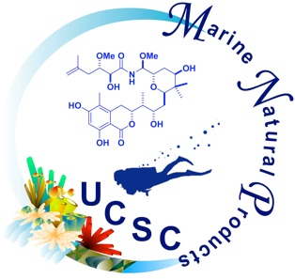





Acknowledgements
Professor Phil Crews & Lab Members
  UC Santa Cruz
    NIH R01 CA 47135
Professor Len Bjeldanes & Dr. Johann Sohn
  UC Berkeley
    NIH Fogarty International Center,
    Indonesian International Cooperative Biodiversity
    Award number 1U01TW008160-01
Principal Investigator, Fred Valeriote
  Josephine Ford Cancer Center
    NIH R01 CA 47135
DUC Graduate & Undergraduate Consultants:
  Matthew Nickel & Natalie Oyler, Victoria Barlow, Brisa Navarette,
  Brooke Young, Linel Tolentino, Angelly Escalante

Slide 21
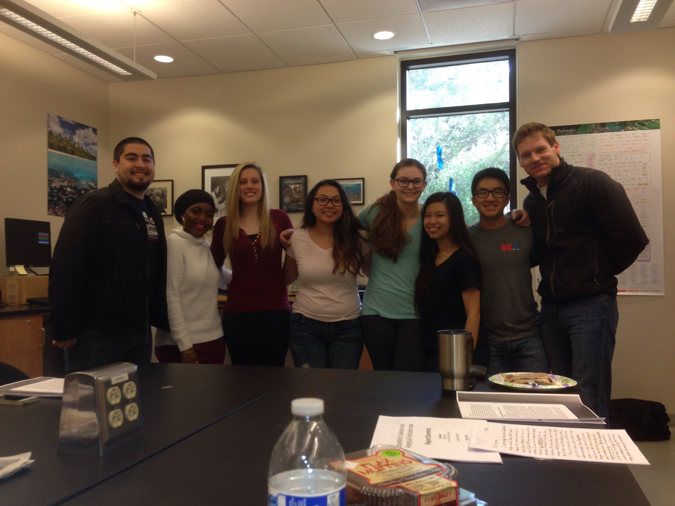










Johnson research lab 2015-16
Johnson research lab 2017-18
Johnson research lab 2019-20

Slide 22


Thank You for your attention ☺
Any Questions?

