Slide 1

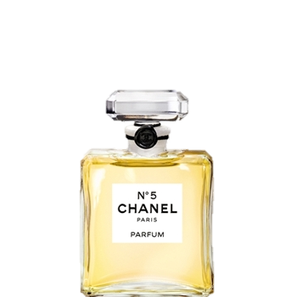
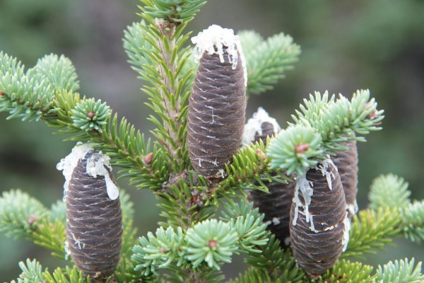
Terpineol
The Smell good molecule
Me
(Photo by Sharon Clark)
Cassandra Re & Nicole McIntosh
Department of Natural Sciences & Mathematics
Dominican University of California
May 8th, 2015
Me
OH
Me
(Photo by Cephas)
(Photo retrieved from chanel.com)

Slide 2
Outline
Background
Discovery
Why Terpineol?
Joys/Concerns
Fun Facts
Acknowledgements

Slide 3
Outline
Background
Discovery
Why Terpineol?
Joys/Concerns
Fun Facts
Acknowledgements

Slide 4
Background
Pine resins are distilled into mainly turpentine and rosin.¹
Turpentine is a pungent oil that is primarily composed of a series of volatile terpenes.¹
Terpenes are made of isoprene units, which, “second to methane, are the most common volatile organic compounds found in the atmosphere.”²
Me
(Photo by Cephas)
Me
OH
Me
(Photo retrieved from chanel.com)
¹Nicolaou, K.C. & Montagnon T. (2008) Molecules that changed the world
²UC Davis ChemWiki: Terpenes

Slide 5
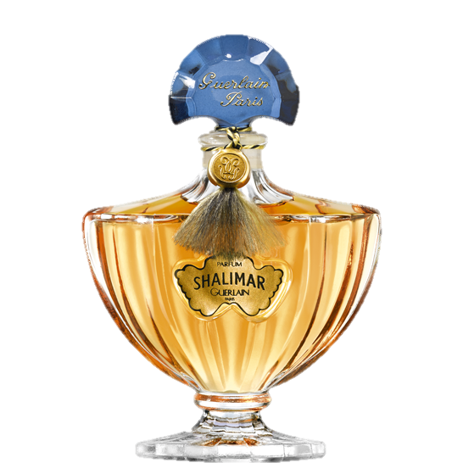
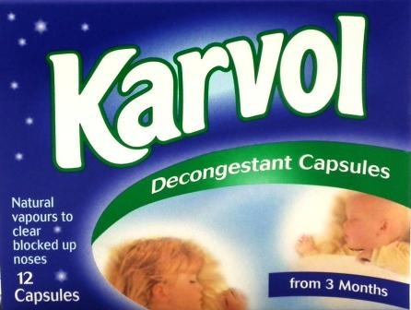
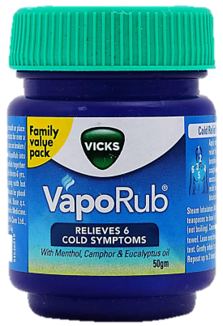
Background
“Monoterpenes (C10 terpenes), such as Terpineol, are unsaturated light oils, generally with heavy scents, that have been used since time immemorial as ingredients, medicines, materials for religious rituals, and perfumes.”
(Photo retrieved from keenpharmacy.com)
(Photo retrieved from guerlain.com)
(Photo retrieved from pharmacylocal.com)
*Nicolaou, K.C. & Montagnon T. (2008) Molecules that changed the world

Slide 6
Outline
Background
Discovery
Why Terpineol?
Joys/Concerns
Fun Facts
Acknowledgements

Slide 7
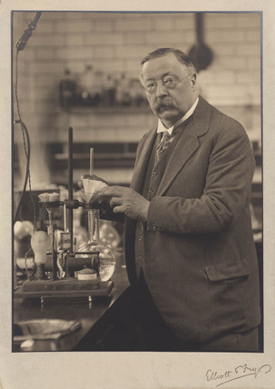
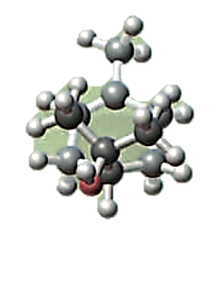
Discovery
Terpineol was discovered in 1904 by William Henry Perkin, Jr at Owens College, Manchester in England.
Perkin set out to synthesize and confirm
the structure of numerous terpenes.
Using the Grignard reaction, he was
able to determine the structures of
several related terpenes, including
Terpineol.
© Science Museum / Science & Society Picture Library
*Nicolaou, K.C. & Montagnon T. (2008) Molecules that changed the world

Slide 8
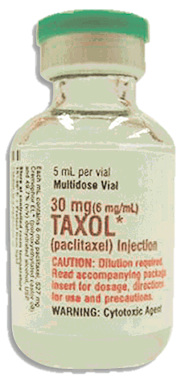
Discovery
Perkin’s synthetic achievement was far ahead of his time.
It was not fully appreciated until the late 1900s, when the vast number of terpenoids and their important roles in our lives became apparent.
“Examples of this ubiquitous class of natural products include all the steroids, many vitamins, and miscellaneous compounds such as the anticancer agent Taxol®.”
©2004 Florida State University
*Nicolaou, K.C. & Montagnon T. (2008) Molecules that changed the world

Slide 9
Outline
Background
Discovery
Why Terpineol?
Joys/Concerns
Fun Facts
Acknowledgements

Slide 10
Why Terpineol?
We chose to make this presentation on Terpineol, because, in reading about it, we discovered that Terpineol is an organic compound that is responsible for the sweet smell of many perfumes.
We found it interesting to learn that such a simple compound can account for the scent of various perfumes, including Chanel No. 5.
Me
Me
OH
Me
(Photo retrieved from chanel.com)
*Nicolaou, K.C. & Montagnon T. (2008) Molecules that changed the world

Slide 11
Outline
Background
Discovery
Why Terpineol?
Joys/Concerns
Fun Facts
Acknowledgements

Slide 12
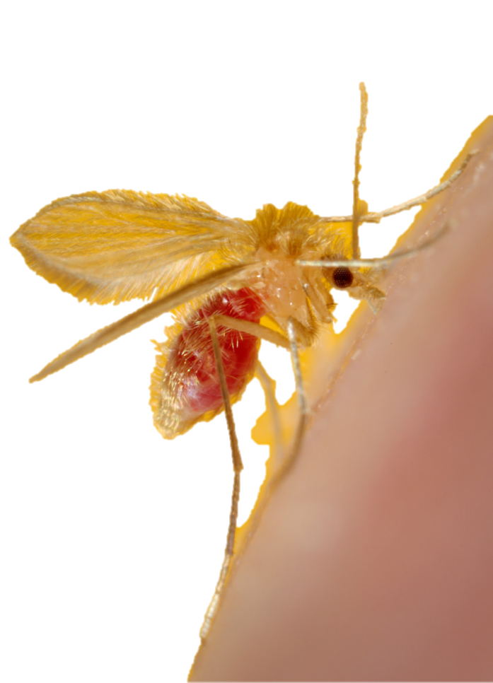
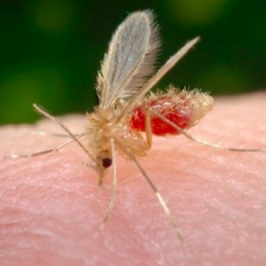
Joys/Concerns
Vector Control:
Fast intercontinental travel and trade has increased the chances of importing nonindigenous insect pests.
Terpineol is used for vector control as an attractant to aid in facilitating the early detection of such pests.
Me
Me
OH
(Photo by Mary Ann McDowell)
Me
(Photo by Mary Ann McDowell)
*Wilson et al., (1989) Use of alpha-terpineol as insect attractant

Slide 13
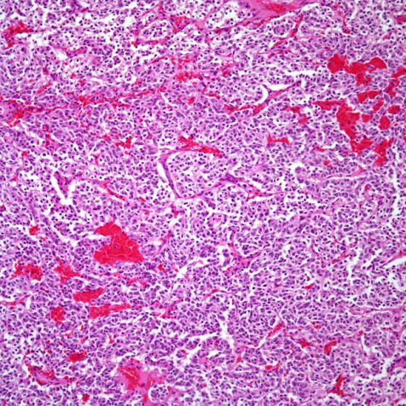
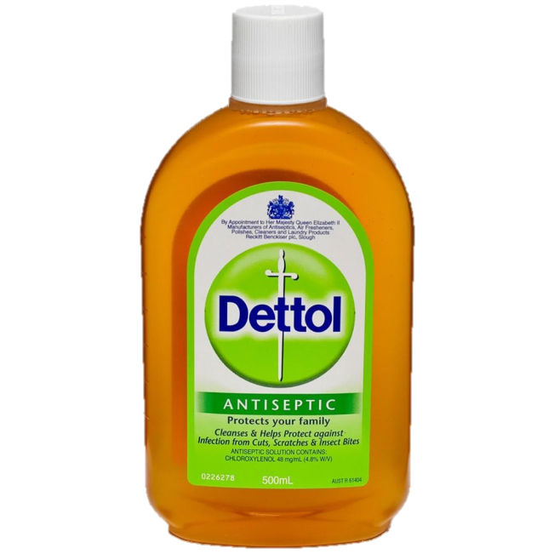
Joys/Concerns
Potential Anticancer Agent
Terpineol has shown cytotoxicity towards different tumor cell lines, particularly that of small cell lung carcinoma.¹
Smells!
Terpineol does not only account for the sweet smell in some perfumes, but also in some paint ingredients, oils for religious rituals, disinfectants, and medicines.²
(Cesar A. Moran, MD)
¹Hassan et al., (2010) Alpha terpineol: a potential anticancer agent
²Nicolaou, K.C. & Montagnon T. (2008) Molecules that changed the world
(Photo retrieved from chemistdirect.com)

Slide 14
Joys/Concerns
Terpineol can be very irritating to the eyes and mucous membranes
If ingested, terpineol can cause acute hemorrhagic gastritis, which is a significant cause of upper gastrointestinal bleeding.
Me
2
1
0
(Santa Cruz Biotechnology: Terpineol Hazards)
Me
OH
Me
*U.S. Department of Labor, Chemical Sampling Info: Terpineol

Slide 15
Joys/Concerns
Terpineol has been reported to increase the absorption of lipid-soluble substances through the skin.
It has also been shown to induce a dose-dependent blockade of the compound action potentials in peripheral nerves of rats.
Since it is a main constituent in most essential oils, commonly used in aromatherapy massages, it is important to understand its physiological effects and its potential for accidental intoxication.
2
1
0
Santa Cruz Biotechnology: Terpineol Hazards
*Moreira et al. (2001) Effects of terpineol on the compound action potential of the rat sciatic nerve

Slide 16
Outline
Background
Discovery
Why Terpineol?
Joys/Concerns
Fun Facts
Acknowledgements

Slide 17
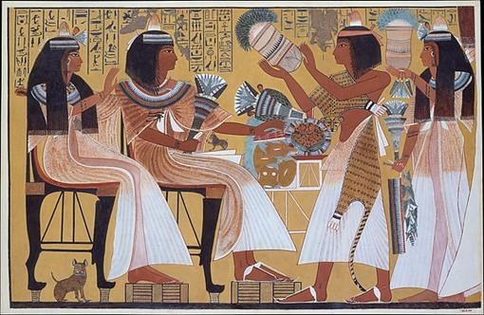
Fun Facts
Originating in Mesopotamia and Egypt, ancient cultures have been combining chemical compounds to mix fragrances for thousands of years. ¹
A study by Keller et al. published in BMC Neuroscience showed that men can smell terpineol better than women. ²
(The Metropolitan Museum of Art)
(chanel.com)
(guerlain.com)
¹Ferreira, A. & Byl, Sheila Ann. (2012) The essence and use of perfume in ancient Egypt
²Keller et al. (2012) An olfactory demography of a diverse metropolitan population

Slide 18
Outline
Background
Discovery
Why Terpineol?
Joys/Concerns
Fun Facts
Acknowledgements

Slide 19

Acknowledgments
Special Thanks to…
Dr. Spain
Dr. Johnson
Dr. Hall
Dr. Protas
Dr. Sevigny
BIO 2990 – Research Methodology

