Slide 1
Outline
Orientation: (15 min) CONSULTANTS
  Syllabus
  Assignments
Introduction to Marine Natural Products Chemistry
& Chemical Biology
Turbo extraction of your sponge CONSULTANTS
Break
Short course in:
  A) Organic Chemistry, B) Polar vs Non polar Chemistry
  B) Drawing BioOrganic & Medicinal Chemistry - Molecular structures
Mini power point tutorial
Adjourn

Slide 2
Break
5 min. intermission

Slide 3
Outline
Orientation: (15 min) CONSULTANTS
  Syllabus
  Assignments
Introduction to Marine Natural Products Chemistry
& Chemical Biology
Turbo extraction of your sponge CONSULTANTS
Break
Short course in:
  A) Organic Chemistry, B) Polar vs Non polar Chemistry
  B) Drawing BioOrganic & Medicinal Chemistry - Molecular structures
Mini power point tutorial
Adjourn
CONSULTANTS

Slide 4
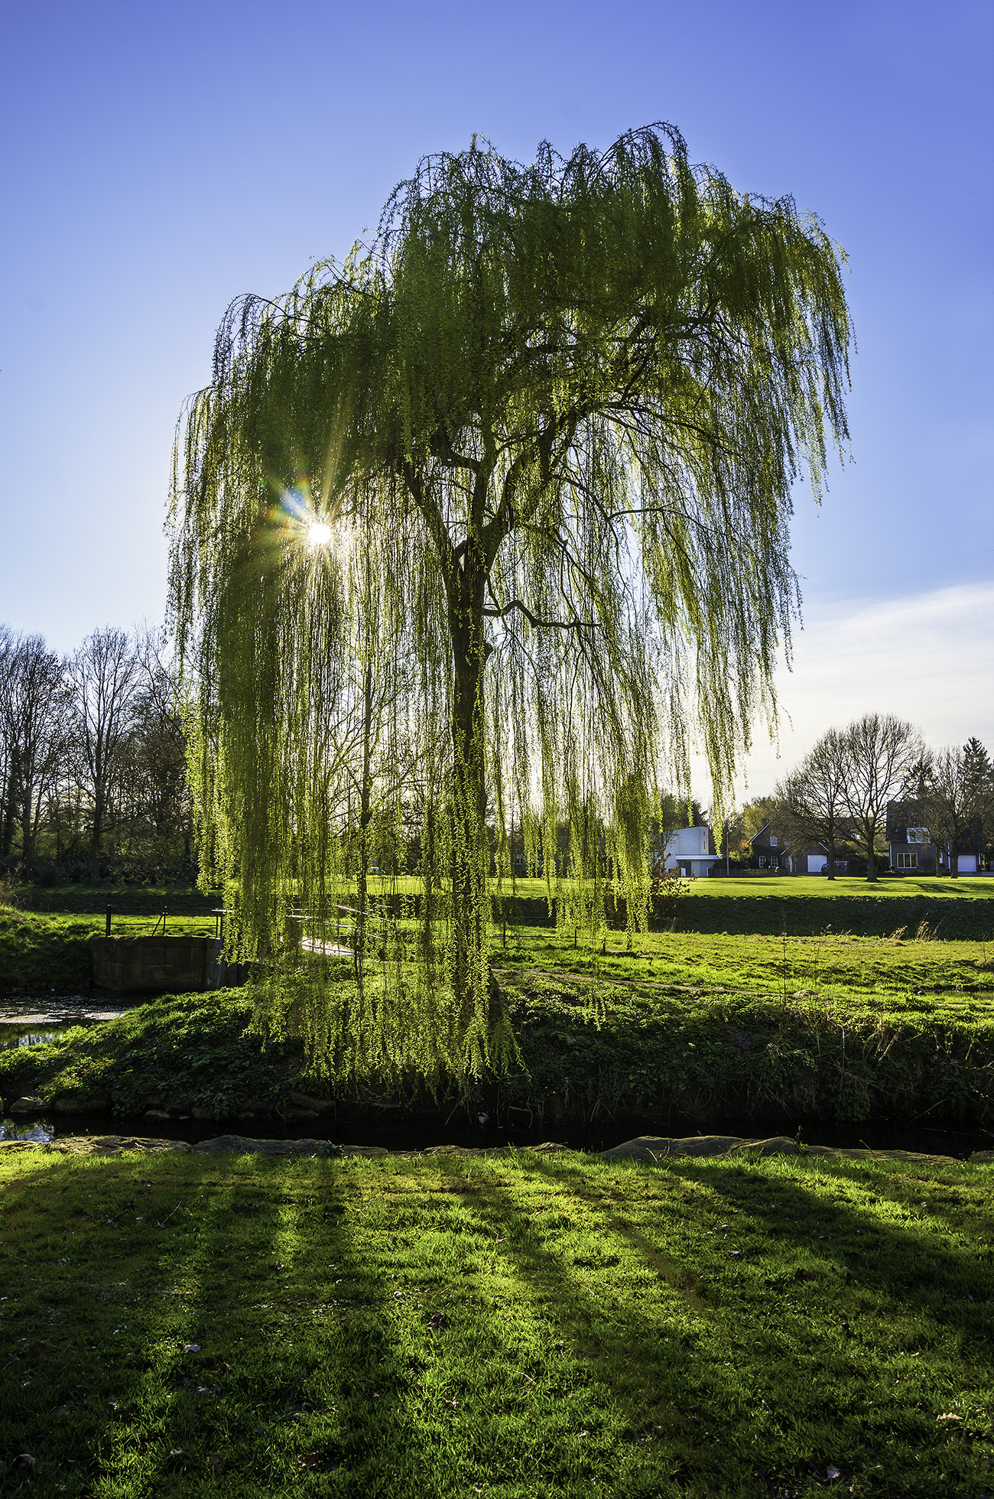
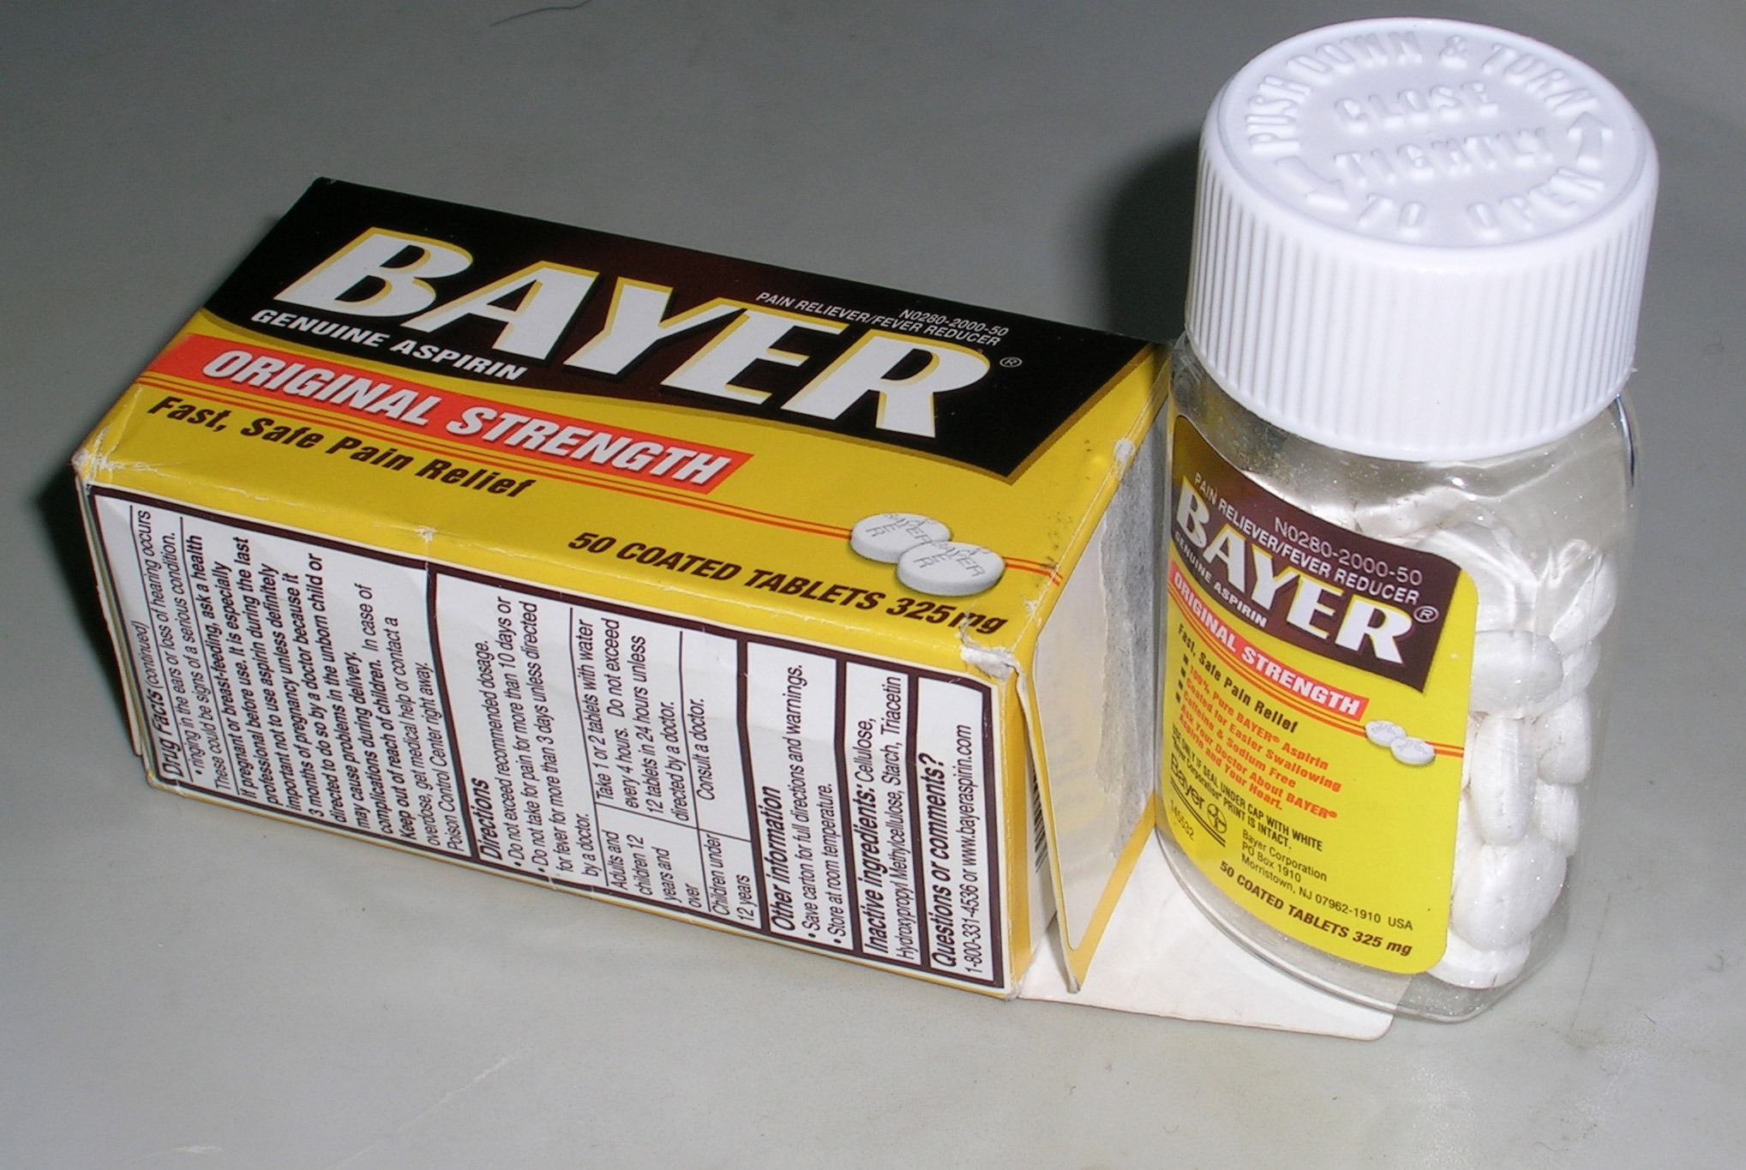
Crash Course in Organic (O) chemistry
Lets draw ☺
C needs 4 bonds – always
Molecular formula matters:
What is it?
C₈H₆O₅
Basis tenant of Organic chemistry
  Making or breaking of bonds to Carbon.
  SHORTHAND
  Line intersections imply presence of carbon
    Don’t draw in C
  Hydrogens implied (don’t draw)
    Unless bound to hetero atom
    e.g. N, O, S etc.
(neophyte view)
(Medicinal Chemistry view)
Salysilic acid
(natural product
from Willow tree)
OAc =
acetyl-salicylic acid in 1853.
Bayer Aspirin
C₈H₆O₅

Slide 5
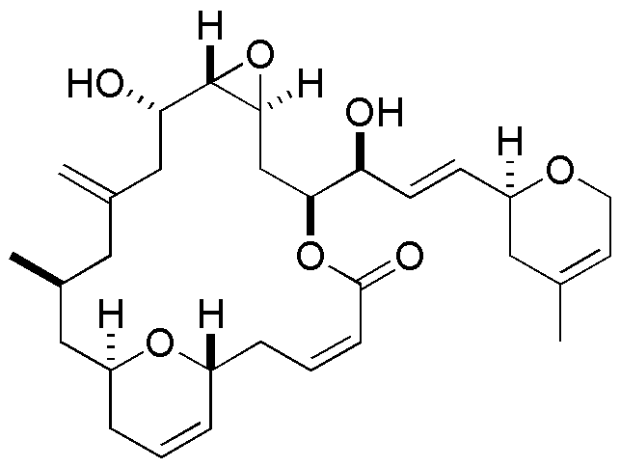
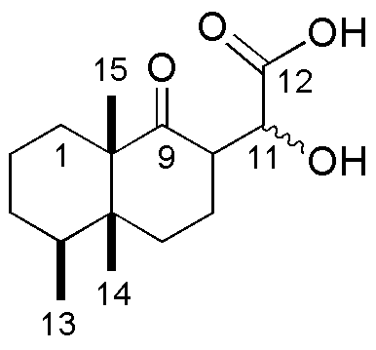
Secondary Metabolite Chemistry & Defining Polarity Index
Divide C# by O & N#
C to O or N ratio ≤ 4
~ polar (water soluble)
C to O or N ratio ≥ 4
~ NONpolar (fat soluble)
Chemotype: aignopsanes
Chemotype: fijianolides
Molecular formula: C₁₅H₂₂O₄
Molecular formula: C₃₀H₄₂O₇
Polarity index = 3.75
Polarity index = 4.3
Polar Chemistry
Water (aqueous) solvent soluble
Non polar Chemistry
Fat (organic) solvent soluble)
Crews et al., 2009, Organic letters, p. 1975
Crews et al., 2007, Journal of medicinal chemistry, p. 3795

Slide 6
Outline
Orientation: (15 min) CONSULTANTS
  Syllabus
  Assignments
Introduction to Marine Natural Products Chemistry
& Chemical Biology
Turbo extraction of your sponge CONSULTANTS
Break
Short course in:
  A) Organic Chemistry, B) Polar vs Non polar Chemistry
  B) Drawing Organic & Medicinal Chemistry - Molecular structures
How to prepare a mini - Scientific power point talk.
Adjourn
CONSULTANTS

