Slide 1
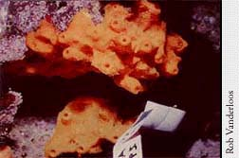
The stellar and splendid derivative of the Jaspis sponge
Madison Sobilo & Hooriya Shaghasi
Department of Natural Sciences & Mathematics
Dominican University of California
February 5th 2021
Vanderloos, Rob. Sponges wage chemical warfare in Indo-Pacific. 1997.

Slide 2
Outline
Background
Biological Activity Reported
Acknowledgements and References
Nonpolar and Polar Chemistry
Conclusions
Interesting Facts

Slide 3
Outline
Background
Biological Activity Reported
Acknowledgements and References
Nonpolar and Polar Chemistry
Conclusions
Interesting Facts

Slide 4
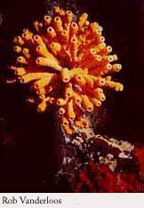
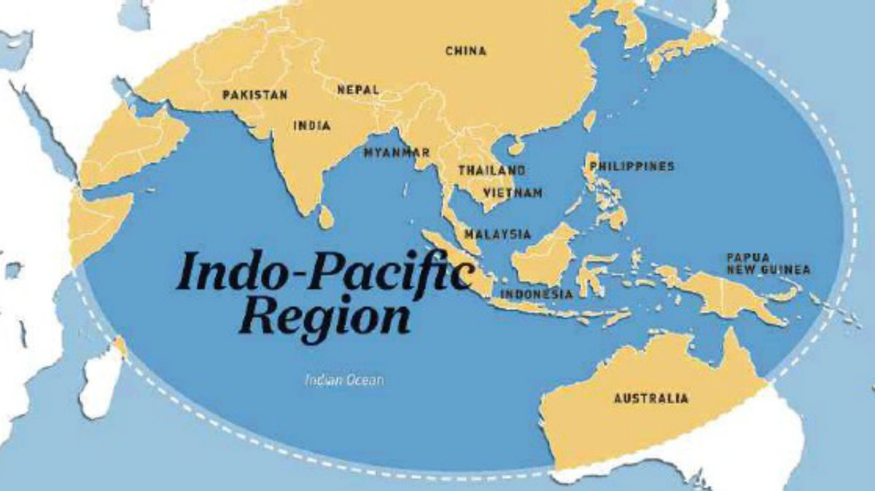
Background
Jaspis- (collection number 95533)
Collected from many locations, mainly the
Indo-Pacific Region:
Kalimantan
Indonesia
Fiji Island
South China Sea
Indian Ocean
Vanuatu Islands, between South Pacific Ocean
Vanderloos, Rob. Sponges wage chemical warfare in Indo-Pacific. 1997.
Vanderloos, Rob. Sponges wage chemical warfare in Indo-Pacific. 1997.
Indo-Pacific Ocean Map, Fresherslive

Slide 5
Outline
Background
Biological Activity Reported
Acknowledgements and References
Nonpolar and Polar Chemistry
Conclusions
Interesting Facts

Slide 6

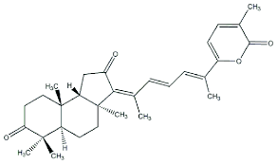
Nonpolar Chemistry
Stellettin B
Molecular Formula: C₃₀H₃₈O₄
Nonpolar Chemistry: Organic solvent soluble
Tang, Sheng-An et al. “In vitro antitumor activity of stellettin B, a triterpene from marine sponge Jaspis stellifera, on human glioblastoma cancer SF295 cells.” Marine drugs vol. 12,7 4200-13. 15 Jul. 2014, doi:10.3390/md12074200

Slide 7
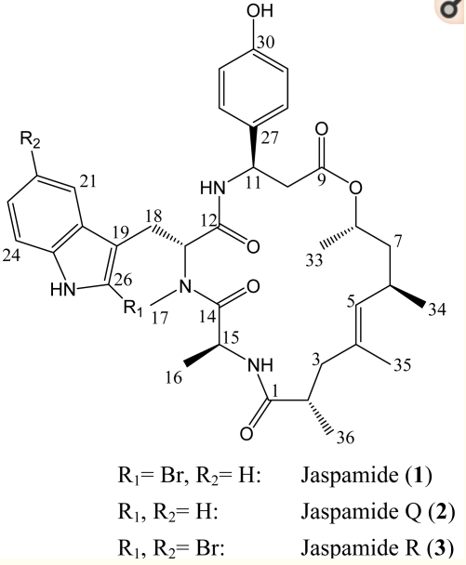
Polar Chemistry
Jaspamide R + Q
Molecular Formula:
Jaspamide R: C₃₆H₄₄Br₂N₄O₆
Jaspamide Q: C₃₆H₄₆N₄O₆
Polar Chemistry: Aqueous solvent soluble
Ebada SS, Wray V, De Voogd NJ, Deng Z, Lin W, Proksch P. Two New Jaspamide Derivatives from the Marine Sponge Jaspis splendens. Marine Drugs. 2009; 7(3):435-444. https://doi.org/10.3390/md7030435

Slide 8
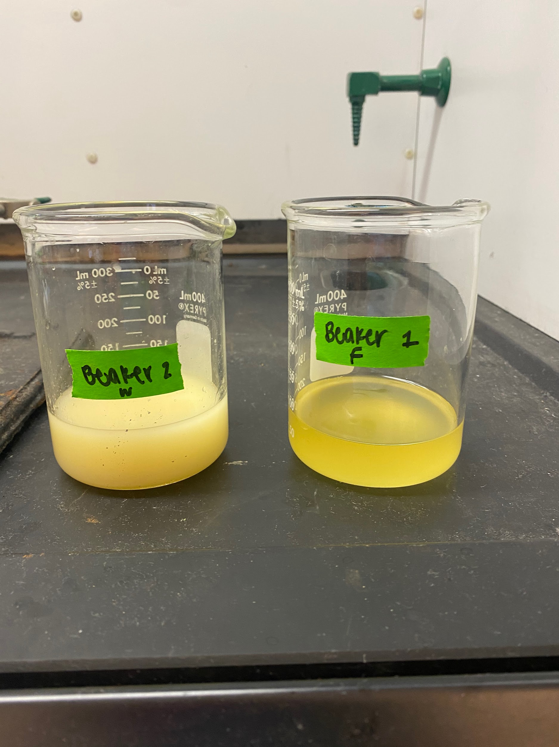
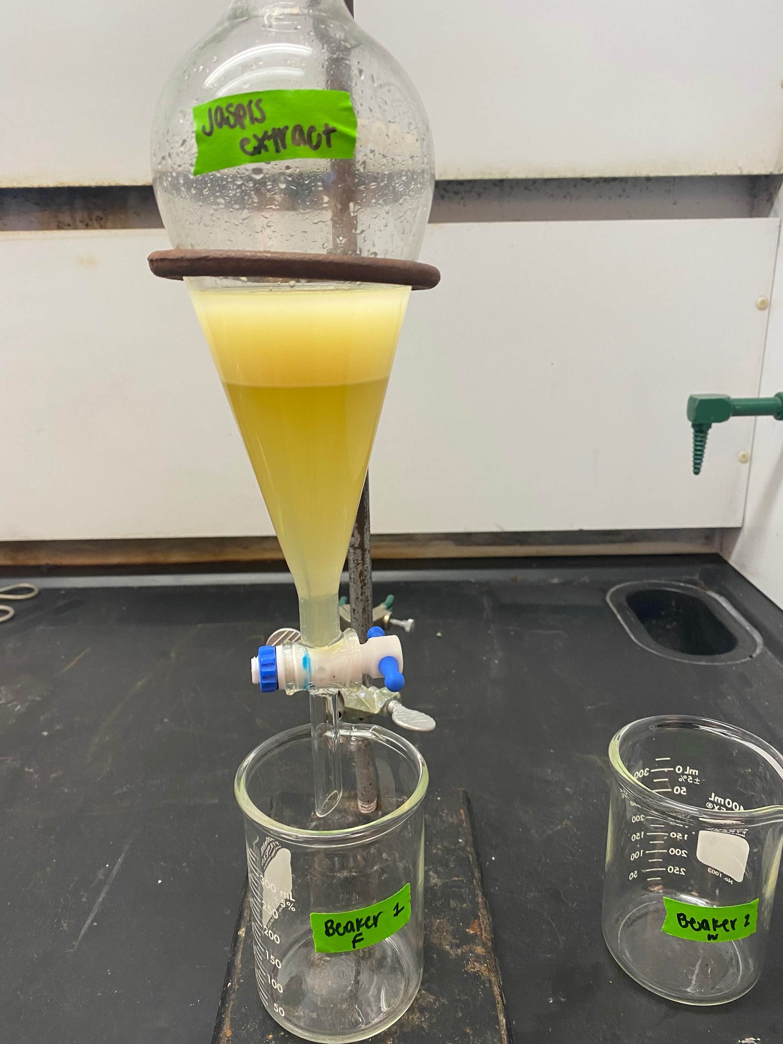

Slide 9
Outline
Background
Biological Activity Reported
Acknowledgements and References
Nonpolar and Polar Chemistry
Conclusions
Interesting Facts

Slide 10
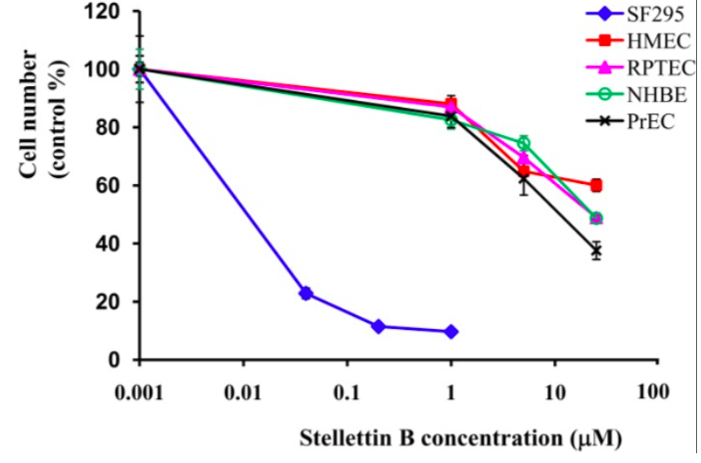
Biological Activity Reported
Jaspis stellifera
Stellettin B
Chemotype: Stellettin B
  Graph depicts how this molecule inhibits cell growth of normal and cancer cells.
Biological Activity:
  Stellettin B results in in vitro antitumor activity
  Cytotoxicity against human cancer cells
Tang, Sheng-An et al. “In vitro antitumor activity of stellettin B, a triterpene from marine sponge Jaspis stellifera, on human glioblastoma cancer SF295 cells.”

Slide 11
Biological Activity Reported
Jaspis splendens
Chemotype: Jaspamide R + Q
Biological Activity:
  J. splendens in vitro cytotoxic activity against mouse lymphoma
Jaspamide
R + Q
Ebada SS, Wray V, De Voogd NJ, Deng Z, Lin W, Proksch P. Two New Jaspamide Derivatives from the Marine Sponge Jaspis splendens.

Slide 12
Outline
Background
Biological Activity Reported
Acknowledgements and References
Nonpolar and Polar Chemistry
Conclusions
Interesting Facts

Slide 13
Conclusions
Stellettin B
May be a lead compound for a discovery of a drug candidate for treatment of part of glioblastomas
Jaspamide R + Q
The start of determining antiproliferative activity in mouse lymphoma
Jaspis sponge is the genus of Jaspis splendens and Jaspis stellifera
-Collected from the Indo-Pacific Region
Could lead to drugs to treat:
-Glioblastomas, carcinomas, and lymphomas

Slide 14
Outline
Background
Biological Activity Reported
Acknowledgements and References
Nonpolar and Polar Chemistry
Conclusions
Interesting Facts

Slide 15

Acknowledgements
A special thank you to:
Dr. Johnson
Professor Joseph Morris
Dr. Spain
Dr. Bower
Dr. Protas
Dr. Hall

Slide 16
References
Tang, Sheng-An et al. “In vitro antitumor activity of stellettin B, a triterpene from marine sponge Jaspis stellifera, on human glioblastoma cancer SF295 cells.” Marine drugs vol. 12,7 4200-13. 15 Jul. 2014, doi:10.3390/md12074200
Ebada SS, Wray V, De Voogd NJ, Deng Z, Lin W, Proksch P. Two New Jaspamide Derivatives from the Marine Sponge Jaspis splendens. Marine Drugs. 2009; 7(3):435-444. https://doi.org/10.3390/md7030435
University of Delaware College of Marine Studies. Smithsonian Magazine.
Sarà, Michele. "Sponge". Encyclopedia Britannica, 6 Mar. 2020, https://www.britannica.com/animal/sponge-animal. Accessed 4 February 2021.

Slide 17
Outline
Background
Biological Activity Reported
Acknowledgements and References
Nonpolar and Polar Chemistry
Conclusions
Interesting Facts

Slide 18
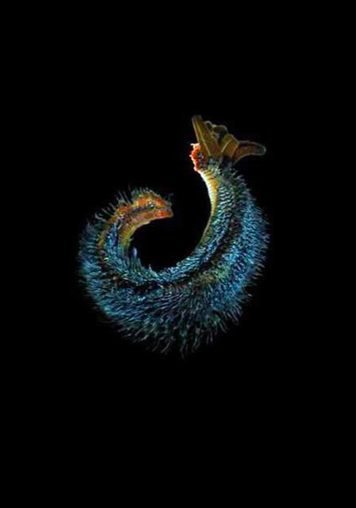
Interesting Facts
Alvinella pompejana
aka Pompeii Worm
Sponges
living animals that live in water. Scientific name: Porifera
The Pompeii Worm is one of the most heat-resistant animals.
This polychaete lives in hydrothermal vents on the ocean floor where they rest in water over 140 degrees Fahrenheit.
Molecular data suggest that both sponges and more-complex animals evolved from a common ancestor.
The animal nature of sponges was confirmed in 1765 after observations of their water currents and the changes in diameter of the openings into their central cavity.
Sarà, Michele. "Sponge". Encyclopedia Britannica, 6 Mar. 2020, https://www.britannica.com/animal/sponge-animal. Accessed 4 February 2021.
University of Delaware College of Marine Studies

