Slide 1
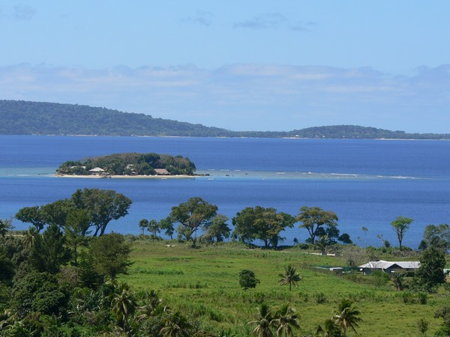
A brief insight into secondary metabolite chemistry reported from Cacospongia
Hideaway, Is.
Vanuatu
Matt Nickel, Natalie Oyler, Tyler Johnson
Department of Natural Sciences
Dominican University of California

Slide 2
Outline
    Background
    Secondary metabolite chemistry
    organic molecular structures
    Biological activity reported
  Conclusions:
  Acknowledgements
    Interesting Insights about natural products chemistry

Slide 3
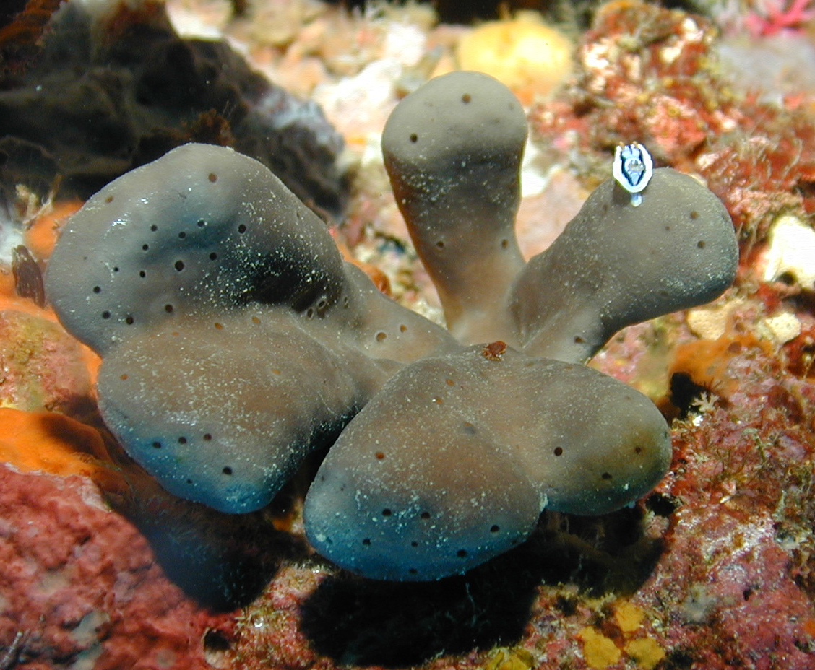
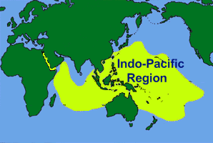
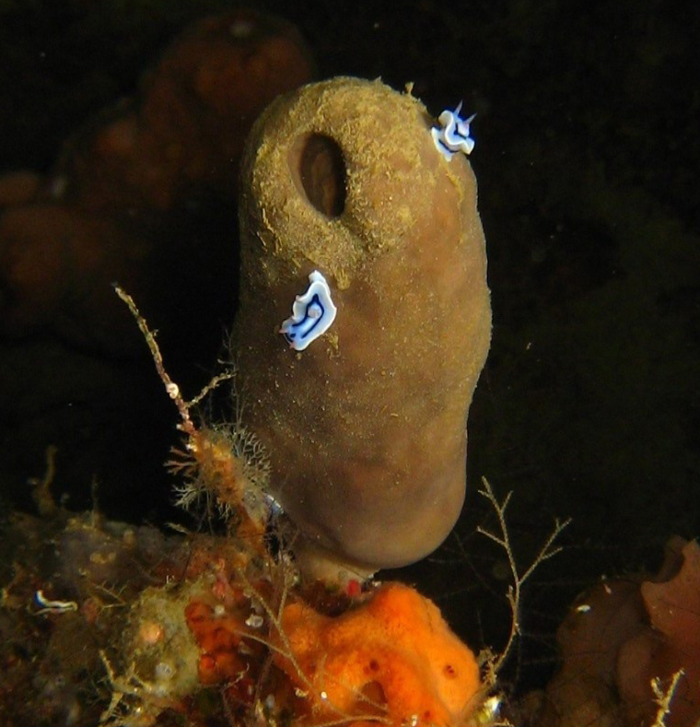
Background – Where found?
Cacospongia mycofijiensis (coll. no 02600, 07327)
  Sponge has been collected at various locations
Selected examples in the Indo Pacific include:
  Vanuatu (Hideaway Is.)
  Papua New Guinea (Long Is.)
abbreviation:
C. mycofijiensis
  Vanuatu (Hideaway Is.)
(coll. no. 02600)
  Papua New Guinea (Long Is.)
(coll. no. 07327)

Slide 4
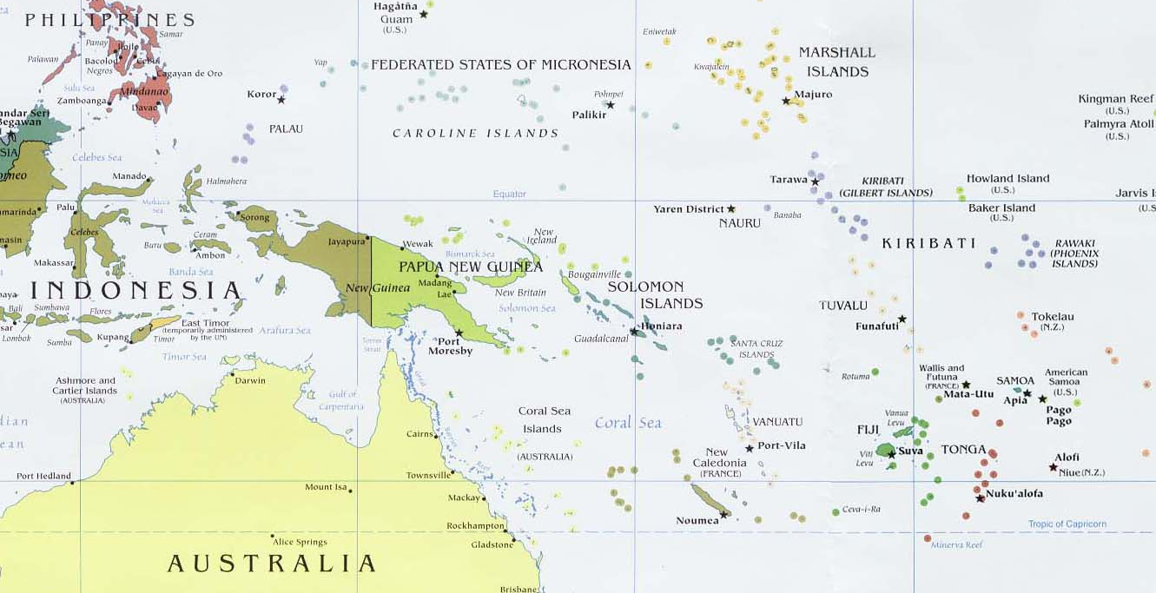
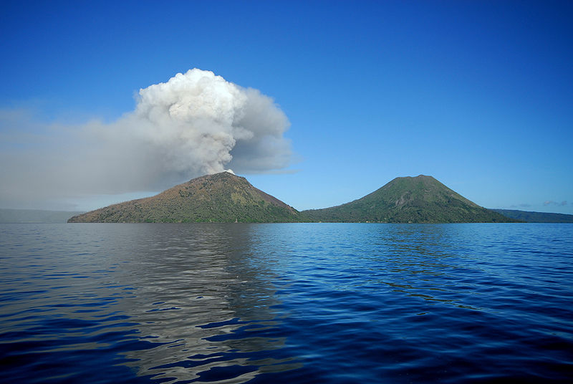
Where found – in detail?
Cacospongia mycofijiensis (coll. no 02600)
  Sponge has been collected at various locations
Selected examples include:
  Vanuatu (Hideaway Is.)
  Papua New Guinea
(Long Is.)
  (Hideaway Is.)

Slide 5
Outline
    Background
    Secondary metabolite chemistry
    organic molecular structures
    Biological activity reported
  Conclusions:
  Acknowledgements
  Interesting Insights about natural products chemistry

Slide 6
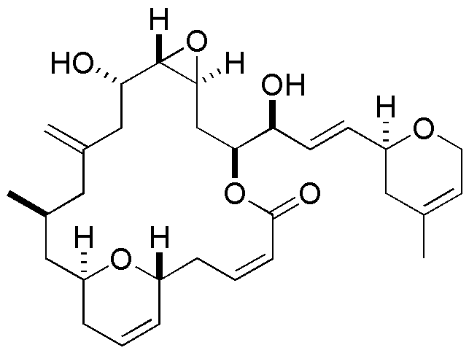
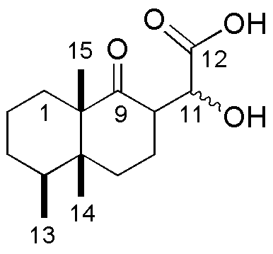
Secondary Metabolite Chemistry & Defining Polarity Index
Divide C# by O & N#
C to O or N ratio ≤ 4
~ polar (water soluble)
C to O or N ratio ≥ 4
~ NONpolar (fat soluble)
Chemotype: aignopsanes
Chemotype: fijianolides
Molecular formula: C₁₅H₂₂O₄
Molecular formula: C₃₀H₄₂O₇
Polarity index = 3.75
Polarity index = 4.3
Polar Chemistry
Water (aqueous) solvent soluble
Non polar Chemistry
Fat (organic) solvent soluble)
Crews et al., 2009, Organic letters, p. 1975
Crews et al., 2007, Journal of medicinal chemistry, p. 3795

Slide 7
Outline
    Background
    Secondary metabolite chemistry
    organic molecular structures
    Biological activity reported
  Conclusions:
  Acknowledgements
  Interesting Insights about natural products chemistry

Slide 8
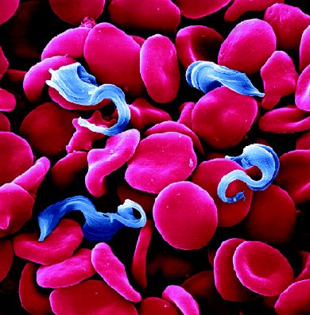
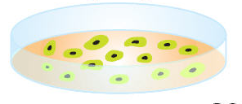
Secondary Metabolite Chemistry & Biological Activity
polar (aqueous) chemistry
Non polar (organic) chemistry
Chemotype: aignopsanes
Biological activity:
Anti-parasitic: Trypanosomiasis brucei
(African sleeping sickness)
Chemotype: fijianolides
Biological activity:
Toxicity to cancer cell lines:
human colon tumor (HCT 116) cell lines
Crews et al., 2009, Organic letters, p. 1975
Crews et al., 2007, Journal of medicinal chemistry, p. 3795

Slide 9
Outline
    Background
    Secondary metabolite chemistry
    organic molecular structures
    Biological activity reported
  Conclusions:
  Acknowledgements
  Interesting Insights about natural products chemistry

Slide 10
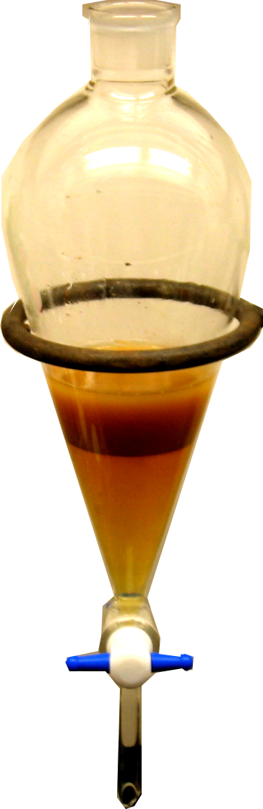
Conclusions
aignopsanes
fijianolides
C. mycofijiensis
C. mycofijiensis
Cacospongia is a source of the aignopsane and fijianolide chemotypes
They have been reported from: Papua New Guinea & Vanuatu
The compounds may serve as therapeutic lead structures for treating:
  1) neglected tropical diseases (African sleeping sickness)
  2) human colon tumors (HCT 116)
% yields of our extracts of Cacospongia (coll. no. 02600) were:
  Aqueous (W) water extract (278.1 mg) _____????
  Organic (F) non polar extract (14.3 mg) _____????
This indicated that our specimen was enriched with:
  polar (water soluble) chemistry suggesting the aignopsanes may be
  the major metabolites
Water (W)
Fat (F)

Slide 11


Acknowledgements
Crews & Lab Members
  UC Santa Cruz
    NIH R01 CA 47135
DUC – PI, consultants
DUC Research Methodology staff
  Dr. Spain

Slide 12
Outline
    Background
    Secondary metabolite chemistry
    organic molecular structures
    Biological activity reported
  Conclusions:
  Acknowledgements
  Interesting Insights about natural products chemistry

Slide 13

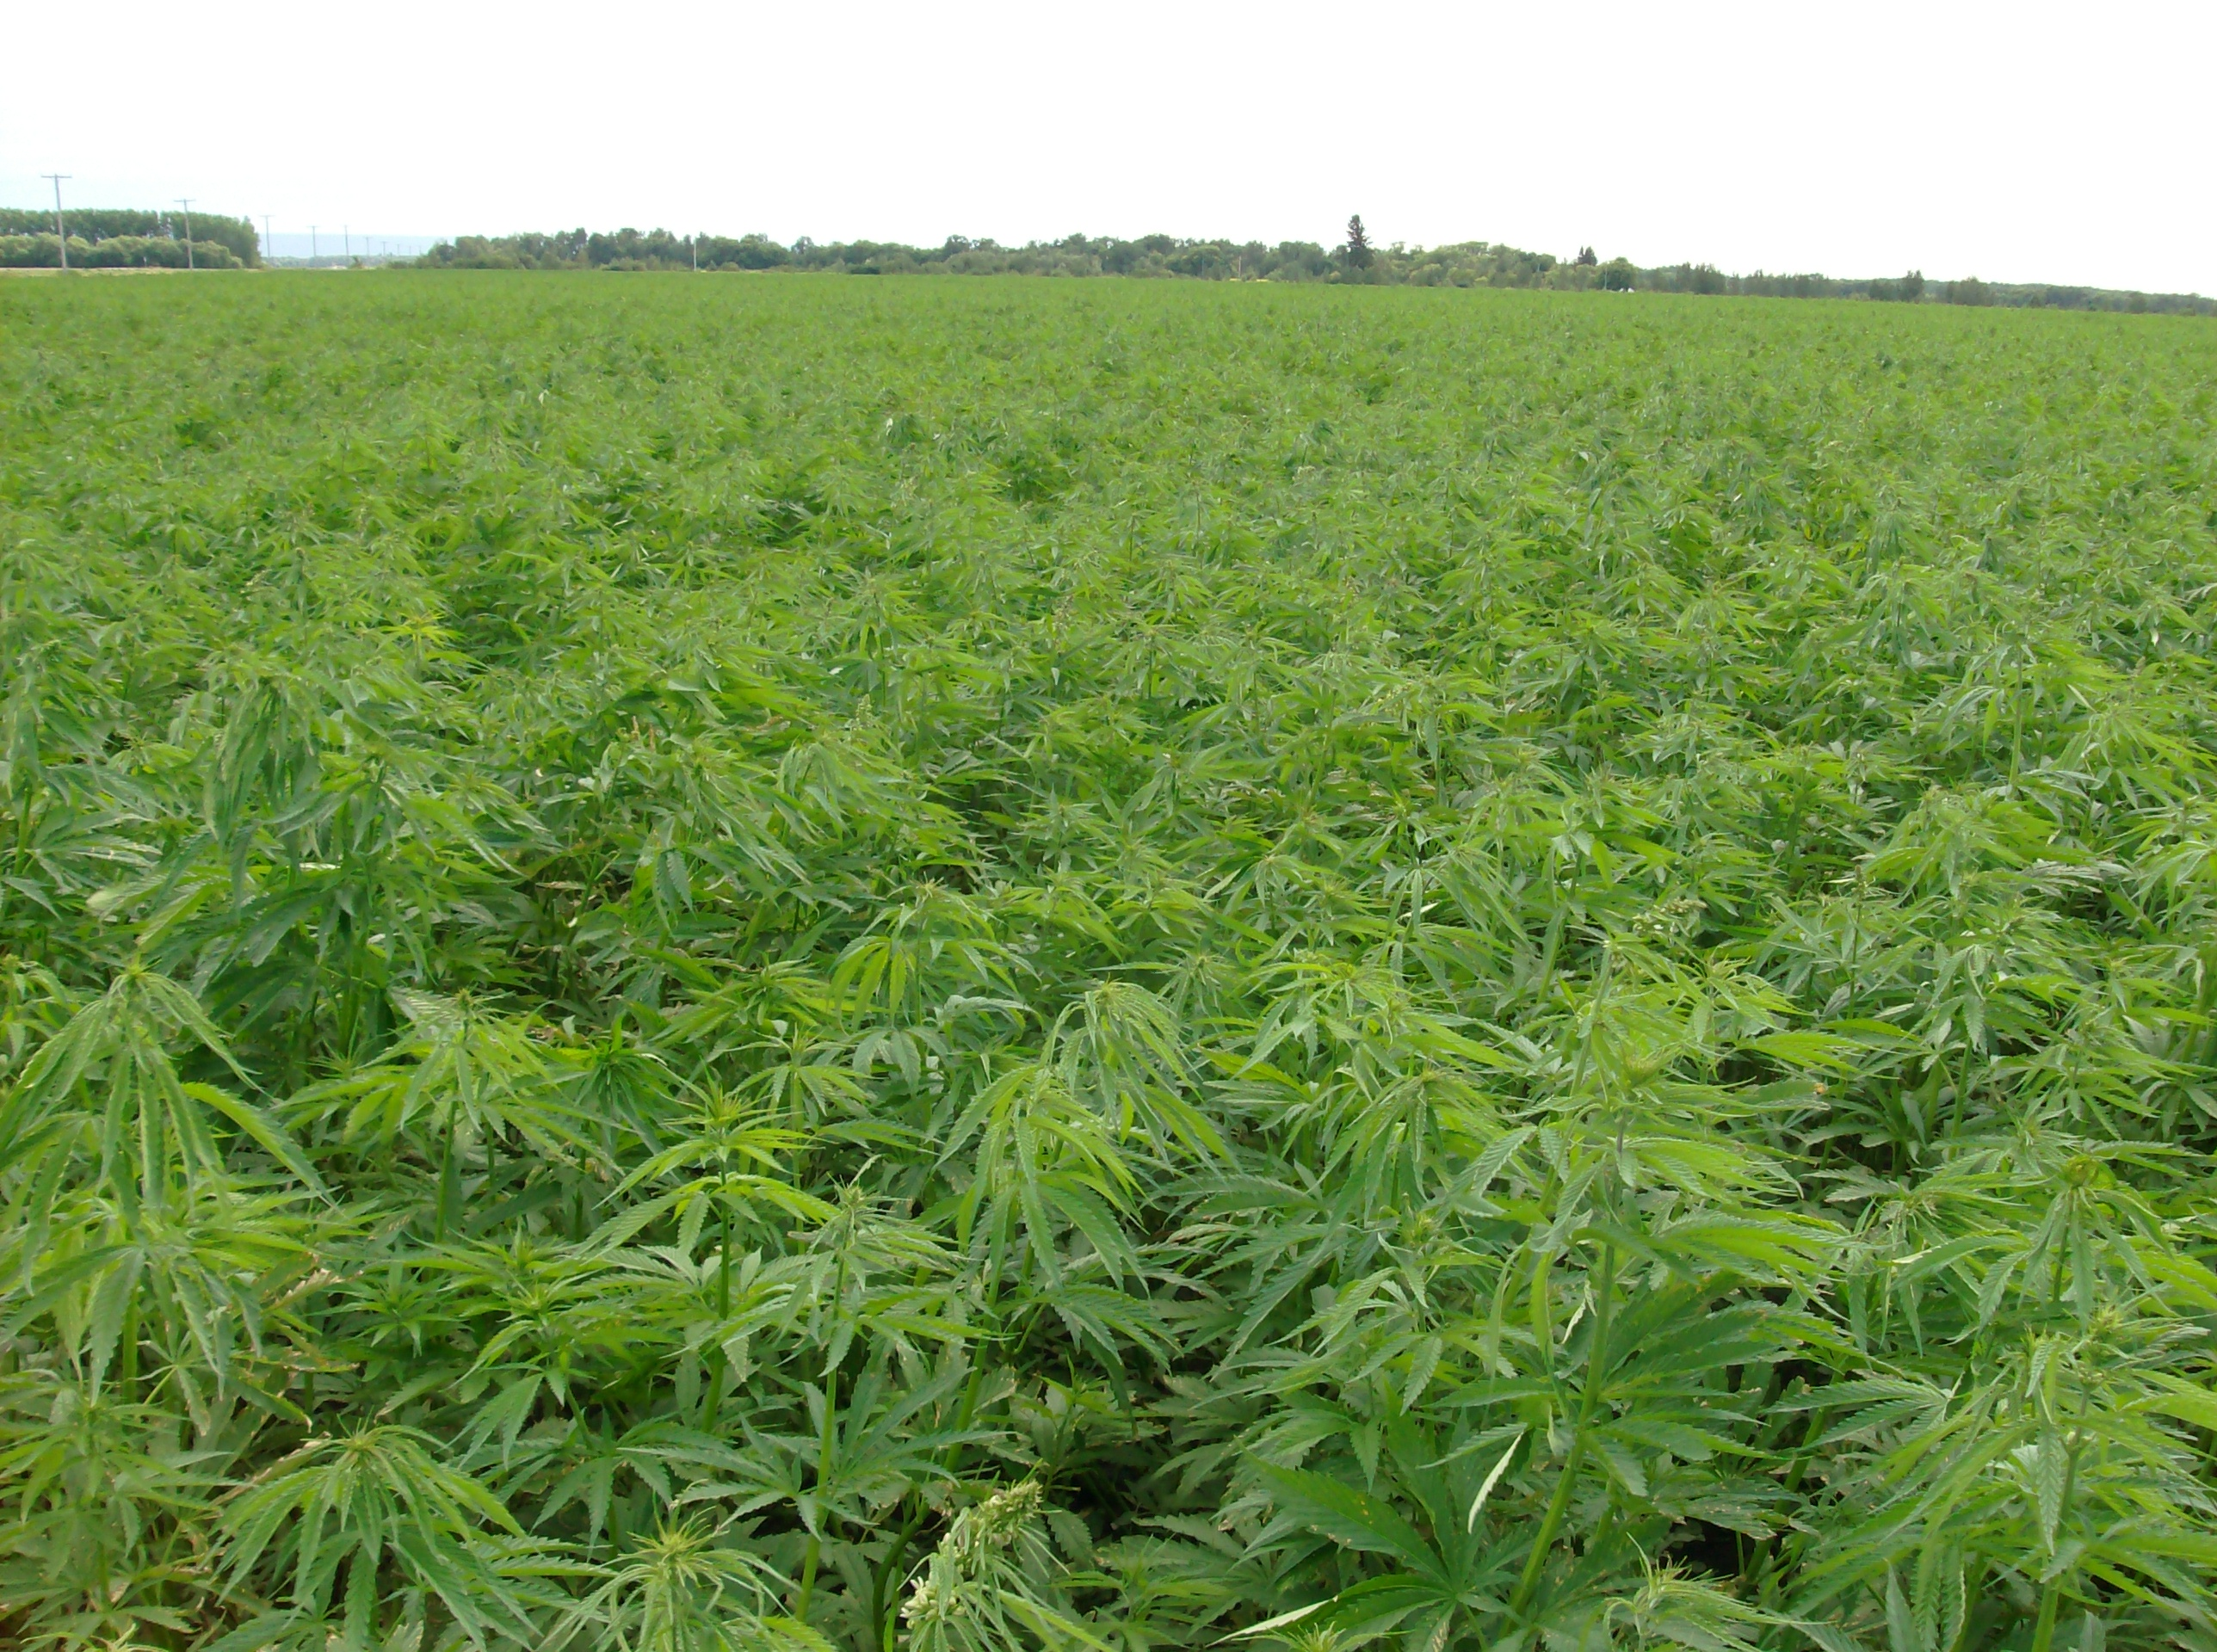
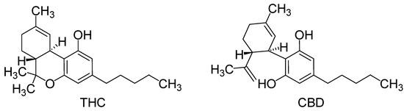
Interesting Insights about
Natural Products
On an annual basis, 1 acre of hemp produces as much fiber as 2-3 acres of cotton.
Hemp fiber is stronger & softer than cotton, lasts twice as long, and will not mildew.
Should and will this ever be legal in the US?
Could it help our economy or hurt it?
- a Research Methodology rotation presentation given: 2016
NOTE: FFwd 1/2026
US DEA – poised to reclassify Medical Cannibis from Schedule I to Schedule III
Reference ?

Slide 14

Have a nice weekend ☺

